Slide 1
St Bernadette
KS2 SATs Briefing for Parents
12th February 2024

Slide 2
Key Stage 2 SATs take place nationally in the week commencing Monday 13th - Thursday 16th May 2024.
Statutory tests will be administered in the following subjects:
Reading (60 minutes)
Spelling (approximately 15 minutes)
Punctuation, Vocabulary and Grammar (45 minutes)
Mathematics
- Paper 1: Arithmetic (30 minutes)
- Paper 2: Reasoning (40 minutes)
- Paper 3: Reasoning (40 minutes)
All tests are externally marked.
As in recent years, writing will be teacher-assessed internally but may also be externally moderated.

Slide 3
Monday 13th May | Tuesday 14th May | Wednesday 15th May | Thursday 16th May | Friday 17th May
Spelling, Punctuation and Grammar Paper 1 (45 mins) Spelling, Punctuation and Grammar Paper 2 (Spelling Test) | Reading Paper (1 hr) | Maths Paper 1 Arithmetic (30 mins) Maths Paper 2 Reasoning (40 mins) | Maths Paper 3 Reasoning (40 mins) | TREAT DAY!

Slide 4
Writing
The children will not complete a writing SATs test.
Teacher assessments in writing provide a rounded judgement that is based on our knowledge of how your child has performed over time and in a variety of contexts.
The judgements are made throughout the course of the year against a set of criteria known as the KS2 assessment framework which is a bullet pointed list of what the expected standard looks like for the end of Year 6.
https://assets.publishing.service.gov.uk/government/uploads/system/uploads/attachment_data/file/740345/2018-19_teacher_assessment_frameworks_at_the_end_of_key_stage_2_WEBHO.pdf

Slide 5
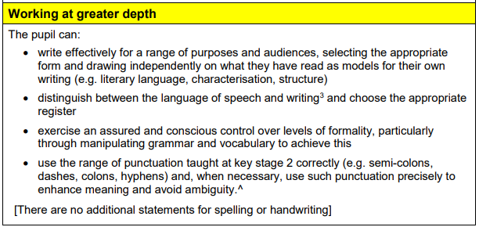
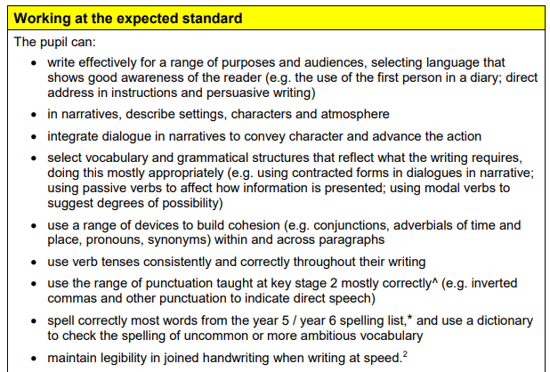

Slide 6
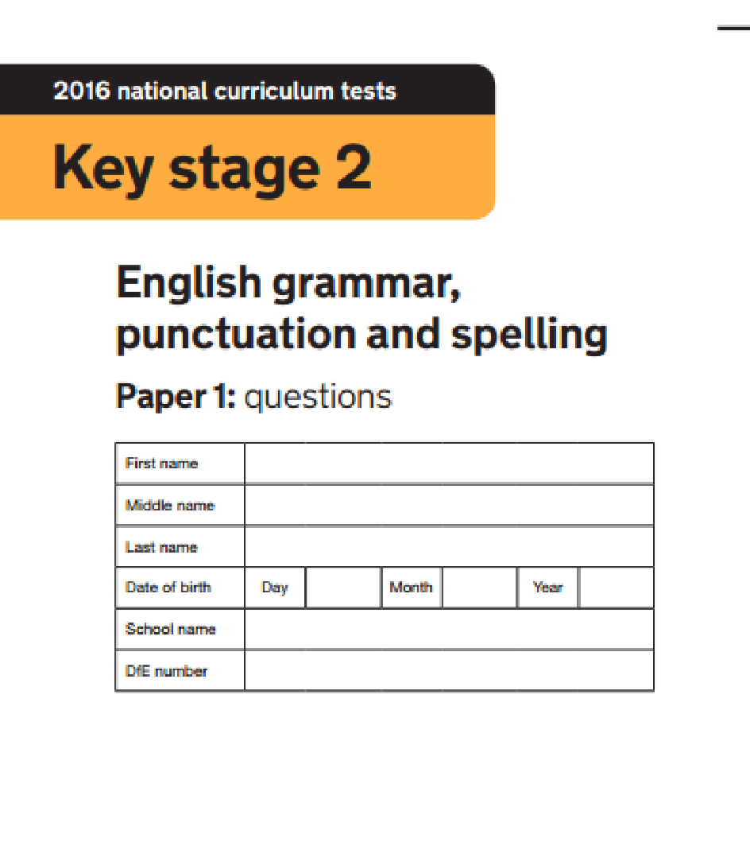
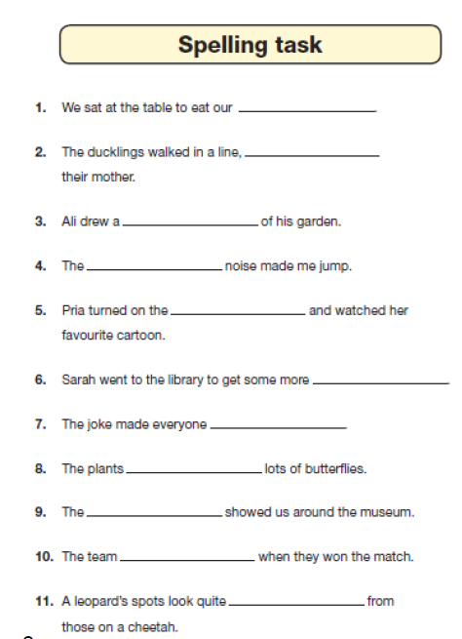
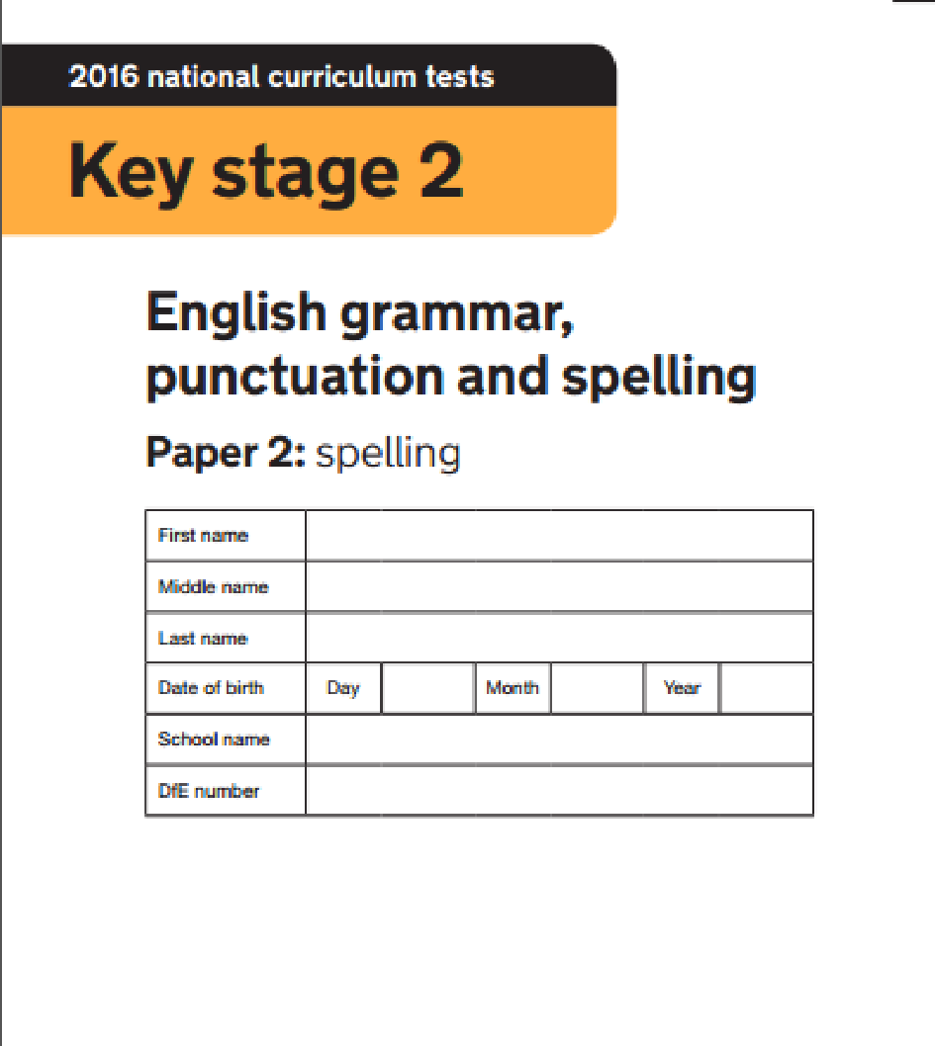
Grammar, Punctuation & Spelling
Test (SPAG or GAPS)
Paper 1 : Short answer questions
Paper 2 : Spelling task

Slide 8
What we are doing at school | What you can do at home
*Weekly SPAG lessons *Practice papers and questions *Specific teaching through Literacy lessons *Regular homework tasks *Spelling dictation practice *Teaching of spelling rules and patterns *Spelling games to practice Y3-6 Common Exception words *Weekly Booster sessions | *Complete homework CGP SPAG tasks *Use CGP Study guide to revise grammar and punctuation *Practice spellings using Spelling Shed *Practice Y3-6 Common Exception Words spellings (see Y6 Resources Google Classroom) and http://spellingframe.co.uk/ - for Y3-6 spelling rules

Slide 10
Reading Test
🞇Greater focus on comprehension and understanding vocabulary.
🞇3 or 4 unrelated texts of increasing difficulty
🞇Mixture of text types –stories, diary entries, reports, poems…
🞇1 hour (for reading the texts and answering the questions)
🞇50 marks
🞇Children will be expected to:
🞇retrieve information (sometimes from a variety of sentences for an answer)
🞇infer meaning from a paragraph or from the texts as a whole
🞇Summarise, compare and give an opinion
🞇Explain why the author uses particular words and phrases
🞇Know the meaning of words or predict them using their prefix knowledge

Slide 12
What we are doing at school | What you can do at home
*Daily reading sessions (mixture of whole class, paired, individual) *Practice Reading tests to develop test technique and reading stamina *Promoting love for reading – class shared book, inviting reading corner, 100 book challenge *Regular comprehension homework (CGP books) *Weekly Booster sessions | *Encourage your child to read as much as possible – fiction, non-fiction, magazines, etc *Record reading in their reading record at least 3x week *Talk with your child about their reading book – discuss vocabulary, make predictions, make inferences (what is meant by certain words/actions), make links with other books/authors *Support homework comprehension tasks

Slide 13
Maths Tests
Arithmetic paper
🞇40 marks in 30 minutes
Questions will include:
🞇Addition/subtraction (1 mark each)
🞇Complex calculations with fractions (1 mark each)
🞇Long division and multiplication (2 marks each)
Two reasoning papers, each paper:
🞇35 marks available
40 minutes.
Problems will include:
🞇Geometry (shape)
🞇Algebra
🞇Measures
🞇All four operations

Slide 16
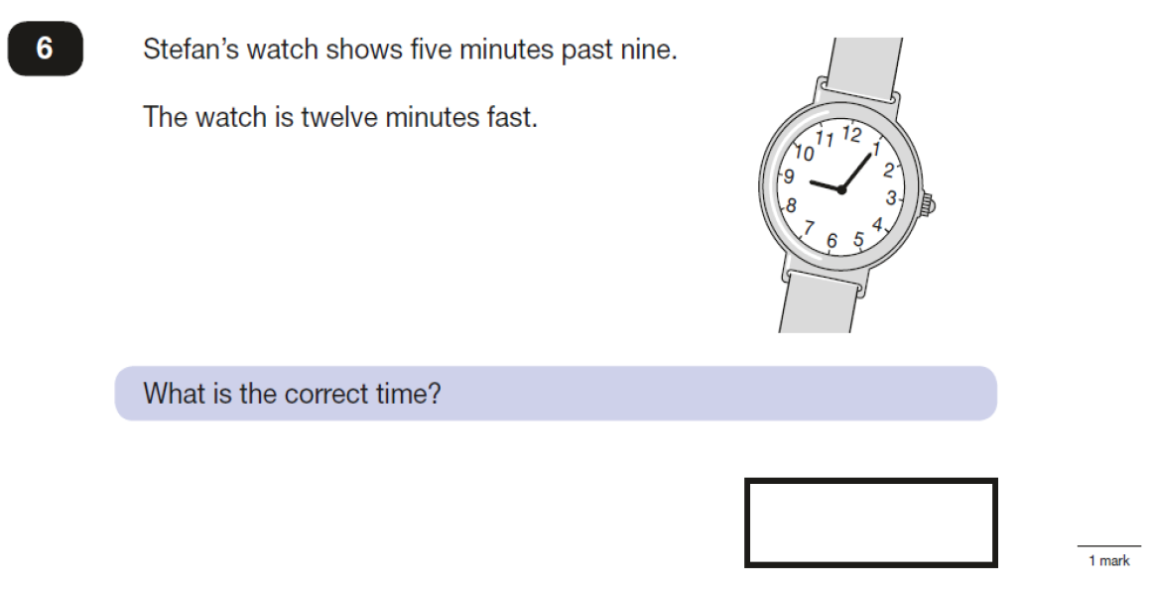

Slide 17
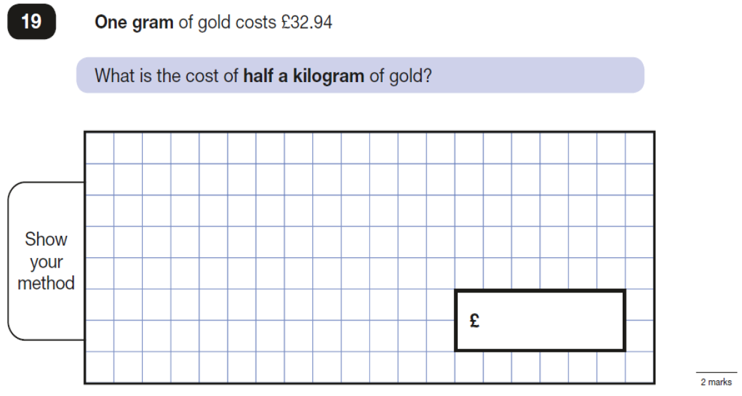

Slide 18
What we are doing at school | What you can do at home
*Daily quick arithmetic practice *Weekly arithmetic tests in class and for homework *Revision of all areas of Maths *Practice reasoning questions and papers *Weekly Booster sessions | *Arithmetic practice *Go through practice papers and focus on topics such as time, measurement, money, etc *Practice fast recall of times tables facts *CGP Maths SAT Busters and study books

Slide 19
How will results be reported to parents?
In your end of year report you will receive:
🞇A teacher assessment judgement (based on the KS2 frameworks) WTS(Working Towards the expected Standard) EXS(Expected Standard) GDS(Working at Greater Depth)
🞇A scaled score - a raw score (The total marks they get on the paper) is converted to a scaled score)
🞇National Standard will be ‘100’ but the raw score that equates to 100 might be different each year. The scores range from 80-120. Usually (but this could change) a child would be working at Greater Depth would score >110
🞇Confirmation of attainment of the national standard or not

Slide 20
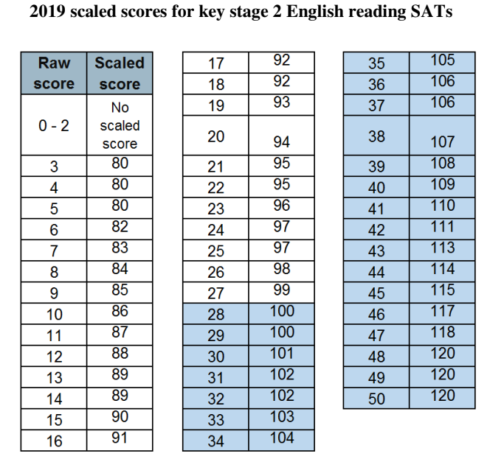
Example Reading Conversion Table
In this example, any child achieving a raw score of 28/50 or more, would be given a scaled score of 100 or more so would therefore be classed as EXS (the expected standard).
A raw score of 41/50 or above would be classed as GDS (working at greater depth).

Slide 21
From now until SATs!...
*Focus in lessons will heavily be on practice and building confidence with applying their knowledge and test technique.
*Morning Booster sessions (small group targeted work with an adult) will continue until Easter
*Praise effort and success
*Identify areas to work on
*Help children not to feel worried or pressured about SATS. All that is asked is that they try their best, but please reassure children that the SATS should not be causing anxiety.
*Help children with organising their homework (including spellings and mental arithmetic) and support their reading for pleasure activities.
*Help them to have early nights and a healthy diet.
*Help your child to have the best possible attendance at school and punctuality.
*Please speak to a member of staff if you have questions or concerns.

