Slide 1
Year 1
Meet the Teacher
September 2022
Welcome to Year 1!

Slide 2
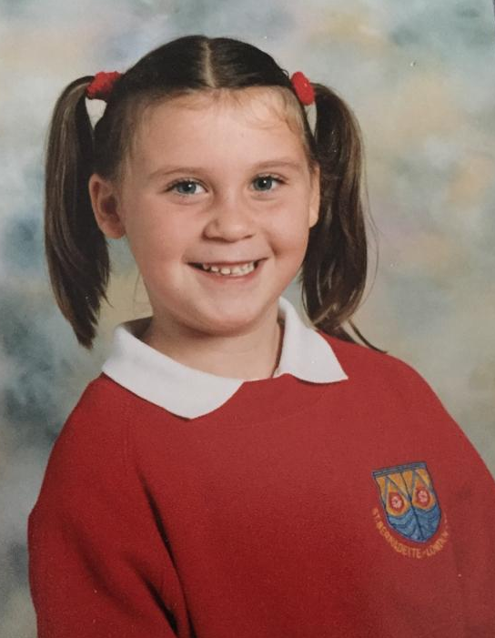
A bit about me!
Teaching Phonics and Early Reading is my passion, and I aim to create an environment that pushes the children to be the best that they can be, to be confident, happy and to love learning!
I went to St Bernadette’s as a child, and this is a photo of me when I was in Year 1!
This is my 7th year working at our school, and my second year in Year 1. I have worked in Reception and Year 1.
I have worked as a TA, HLTA and Class teacher!
I achieved a First Class Honours degree in Early Childhood at The Open University, whilst working full time at St Bernadette.
I also completed a SCITT programme to complete my teaching qualification. I specialised in the age range 3-7.

Slide 3
Staff in Year 1
Class Teacher- Miss Broom
Teaching Assistant- Mrs Bowers
Additional Support TA- Mrs Fitzgerald
PPA Cover- Mr Riley
Every teacher is given PPA time each week (planning, preparation and assessment time). My PPA is on a Monday, therefore Mr Riley will be teaching on a Monday.

Slide 4
What is different in Year 1?
-Year 1 can be quite a shock for children initially, so please do not worry! I am doing everything possible to support their transition, and they are coping amazingly!
- There is no choosing time in Year 1, however I have introduced something this year called Discovery Time (which I will cover in more detail later on in the presentation).
-The children have a book for every subject, and have distinct lessons for every subject in the National Curriculum. Subjects in Year 1 include: Literacy, Maths, Phonics, RE, PE, Topic (which is split into History and Geography, alternating each half term), Science, Music, RSE/PSHE and ART/DT.
-There is no Tapestry! We will now be using Google Classroom, which I will explain in more detail in the presentation.

Slide 5
Autumn Term Timetable
This is our timetable for Autumn 1. We continually review this to meet the children’s needs and to adapt to any changes that may arise. Any changes that will impact you or your child will be communicated!

Slide 6
 | Monday ( PPA) | Tuesday | Wednesday | Thursday | Friday
8:45 - 9:00 | Register, morning tasks- busy finger style/differentiated for each group- Follow Ups completed in this time
9:00-9.20 | Assembly- Roll of Honour | KS1 Assembly (Fortnightly) | Phonics | Phonics | Assembly - Worship 9-9:30
9.20 - 10:10 | Computing 9:30-10:15 | 9:20-9:40- Phonics | Literacy | RSE/PSHE | Phonics 9:30-9:50
10:10-10:30 | Story ( Book for Lit) | 9:40-10:15- Literacy | Guided Reading | Music 10.00 - 10.30 | 9:50-10:30 Maths
10.30 -10.45 | Breaktime and snack outside- relaxing time when back into class until 10:50
10:50 - 11.10 | 10:50-11:25- RE Reflection | Maths | Maths | Literacy | RE
11.10 - 11:45 | 11:25-11:45- Guided Reading | Maths | Maths | Literacy | RE
11:45 - 13.00 | Getting ready for lunch/lunchtime
13:10-14:00 | 1:10-2:10 ART/DT | PE until 14:15 (Little Wandle Intervention) | Topic SPAG | Science | Free Write/ Guided Read 1:30-2- Classroom PE
14:00-14:40 | Finish Art/DT 2:10-3- Whole class intervention- CL FOCUS- Show and Tell | LIBRARY TIME Discovery/ Intervention Time (Maths Support group) 1:1 Support | Discovery/ Intervention Time (Little Wandle Intervention/1:1 support | Finish Science Discovery/ Intervention Time ( 1:1 support) (Writing Support) | Discovery/ Intervention Time (Little Wandle Intervention/1:1 support) (Challenge Time)
14:40-15:00 | Whole class intervention- CL FOCUS- Show and Tell (Diane- Little Wandle Intervention) | Guided Reading Then Singing Hands Makaton | Whole class intervention- FINE MOTOR/ EAD FOCUS (dough disco/ draw with Rob) | Guided Reading Then Singing Hands Makaton | Whole class intervention- VOCABULARY FOCUS (describe a picture on the board game)
15.00-15.15 | STORY and getting ready for home time- handwriting, one group each day with TA

Slide 7
What is Discovery Time?
Discovery Time is a time where the children can “discover” things for themselves and take some ownership of their learning- it is very similar to choosing time in Reception, in that it is child-initiated. The children can choose what they do in this time.
CHALLENGES-Around the room there are challenges that the children can complete. There are easier and trickier challenges for Literacy, Maths and Science. These are optional, however if the children complete them, they will move along the race track. The first person to reach the finish line will receive a prize!
The children have the freedom to choose a range of other activities: re-telling or creating their own story in the story-telling area, sensory activities, quiet reading, independent writing, playing with the small world, construction, role play and dressing up etc.

Slide 8
Whole Class Interventions/Individual Support
On the timetable, you can see that I have scheduled in some whole class “interventions”. This is simply designated time to work on areas that I feel are a particular focus for the class as a whole.
Follow Ups- each morning the children will be pulled to work on any “follow ups” from yesterday’s lessons- this is a time where they can address any misconceptions.
Handwriting- at the end of the day the children will work on their handwriting in small groups on a carousel- one day a week.
1:1 Support- as required
Small groups- I will pull children during Discovery Time to work on different areas of need.
Little Wandle intervention- phonics intervention

Slide 9

Emotional Wellbeing
A big focus for me in my classroom is emotional wellbeing and my priority is building the children’s resilience- this is something I will teach them from day 1.
I am using the Zones of Regulation in my classroom, so you may hear the children talking about these colours! (PLEASE NOTE THEY ARE NOT CONNECTED TO THE BEHAVIOUR SYSTEM, AND ALL FEELINGS AND ZONES ARE OK!)
My focus will be on teaching the children strategies to cope with their different feelings and being able to regulate their emotions so that they are ready to learn.
I am very focused on instilling confidence- nothing is too hard, you can do anything you put your mind to, just try your best and be confident in your abilities and know that we are all here to help!
You may hear “it’s too hard!” “I don’t know how to do it”- Year 1 is a big jump to the National Curriculum, but I can assure you that the children are individually supported to ensure that nothing is out of their reach, and many times the children may tell you this at home, but they are absolutely fine in school!

Slide 10
Autumn Term Planning
Phonics- Recap of Phase 3 and then beginning Year 1 Little Wandle Phase 5
Literacy- Labels, lists and captions, Poetry/Rhyming Couplets, Narrative with Predictable Phrasing
(SPAG focus on applying phonics to spell words, plural endings -s or -es, suffixes -ed, -ing, finger spaces, capital letters and full stops, spelling Year 1 CEW).
Maths- Maths No Problem programme- Number: place value, addition and subtraction within 10 and then within 20, writing numbers in words
Topic- Geography- Local Geography, our area and the UK
Science- Animals including Humans
PSHE/RSE- PSHE focus using books
PE- Fundamental PE skills
Art- Fundamental Art Skills

Slide 11
Phonics, Phonics, Phonics!
Year 1 is the year of phonics!
In Reception, the children covered Phase 2, Phase 3 and Phase 4. In Year 1, they will recap these, and then move on to Phase 5.
Phase 5 involves a lot of alternative graphemes, and I will provide a lot of videos to support you with this on Google Classroom as I recognise that this may be very confusing for those of you that are new to Phase 5 phonics!
I will support you with phonics as much as you need, so please let me know if you have any problems.
I would STRONGLY encourage you to support your child’s phonics as much as possible. It is VITAL to their learning- it includes reading and writing and strong phonics skills enables them to showcase their learning in every subject, improves their independence, boosts their confidence and really makes school a lot easier for them if they are confident in phonics.
I provide a LOT of phonics support in school, but working at home makes a real difference.
PHONICS SCREENING TEST- JUNE 2023- What is this? This is a compulsory test that all Year 1 children across England take. I have provided more detailed information on the school website.
We aren’t simply working towards a “test”- it’s not about passing the test to me, but it’s about ensuring we give our children the best chance to achieve their best.

Slide 12
Reading, Guided Reading and Go Read
In Year 1, we continue to follow the Little Wandle format of Guided Reading, which runs on a 2 week schedule. Over a 2-week period, each child will read with an adult in their group 3 times.
One session focusing on decoding, one on expression and one on comprehension skills.
There will be 2 comments uploaded onto Go Read- one for the decoding session and one for the comprehension session.
The children are allocated books based on their phonics assessments, and will be assessed every half-term. Please do not panic if your child’s label says “Reception” or if they have moved backwards since the Summer- I am continuously assessing them formally and informally!
You will take home a different book that you should upload onto Go Read. I would encourage daily reading, and at least one post onto Go Read each week. Books will be changed on a Friday, however they must have their books in school every day.
We will pull children for additional reading sessions, in which we will read their book that they have taken home, so please ensure this is in school every single day.
The children will take home a library book, this is entirely their choice of book and is about reading for pleasure!

Slide 13
P.E.
P.E. lessons take place every Tuesday afternoon this term (and we will do some classroom-based/outdoor PE themed games on a Friday afternoon).
Please ensure the children have a full, NAMED PE kit in school. This will be taken home each half term to be washed.
Please do not send in shoes with laces- plimsolls or velcro trainers..

Slide 14
Google Classroom
Google Classroom will be used this year, in line with the rest of Key Stage 1 and Key Stage 2.
Each child/parent has their own individual login for Google Classroom. I have stuck a sheet into the front of their homework book with this login to remind you, however they all follow the structure of:
Email- 20FirstnameSurnameinital@stbernadette.herts.sch.uk
E.g. 20JohnnyS@stbernadette.herts.sch.uk
(First letter of first name, and the surname initial must be capital letters!)
Password- sunset33

Slide 15
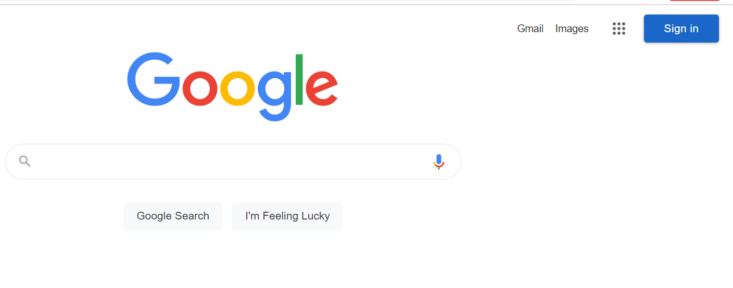
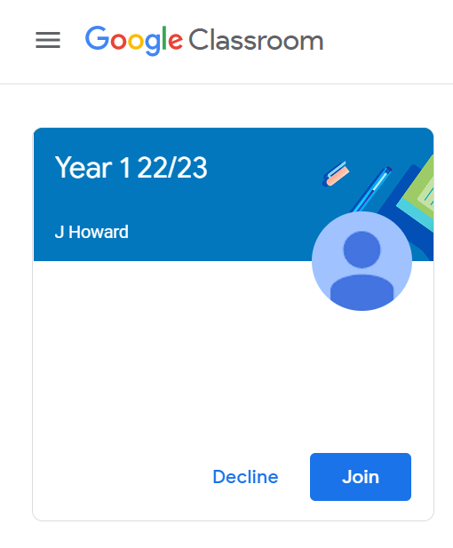
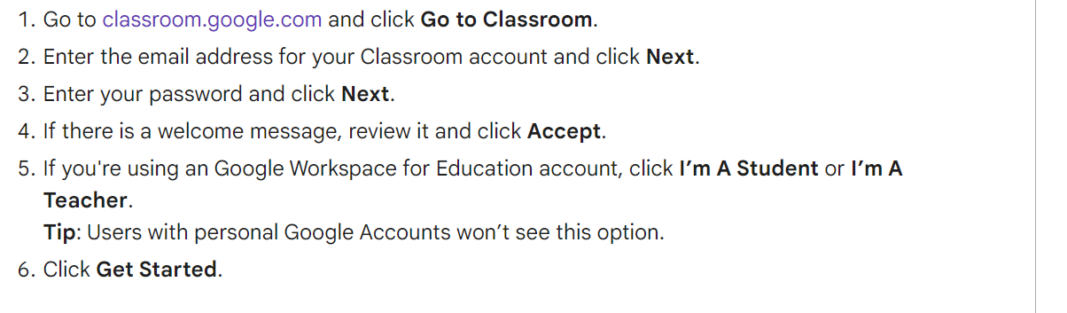
How to get onto Google Classroom?

Slide 16
Communication
Google Classroom is very different to Tapestry, in the sense that it is not a form of communication for you to send messages to staff on.
Across the school, Google Classroom is used to post homework onto and any support resources and videos.
I will try to upload some pictures of some of the exciting things we get up to, as I know how lovely this part of Tapestry was!
If you have any questions or anything you would like to discuss, please let me know! I am more than happy to talk about quicker things at the door at drop offs/pick ups, and if it requires anything longer, just grab me at the door and we will schedule in a time to talk!

Slide 17
Google Classroom
Homework will be set via Google Classroom, however I will not ask you to check in homework via Google Classroom! All homework will be completed in physical exercise books- each child will have their own homework book.
Show and Tell pictures can be uploaded onto Google Classroom. You can upload them directly onto the stream.
Later in the year, the children may be set homework through Purple Mash or My Maths, however I will send you the log ins for these later in the year!

Slide 18
Homework
First of all, I must stress that homework is intended to HELP, not cause stress! I appreciate that life gets chaotic at times, you are all very busy, and that children can be not so willing to work by the time they get home!
I would really encourage you to complete homework, as it takes the form of pre-teaching and aims to best prepare the children for the week ahead. However, please feel free to adapt the work to suit the needs of your child- whether that’s completing less questions, or extending your child and creating challenges, or slightly adapting the task to focus more on your individual child’s target.
Across all year groups, homework will not be marked, however I will keep track of who has completed their homework and I will be looking at the homework books regularly.
Homework is set on a Friday, and is due in by Wednesday. In an ideal world, homework would be completed by Tuesday to ensure the children are prepared for the lesson focuses the following week, but if you have had a particularly busy week, returning the homework book on the Friday is ok.

Slide 19
Homework
Homework is as follows:
Year 1
Weekly:
Weekly phonics videos uploaded on a Friday with supporting sheet and writing activity
Weekly maths task (occassionally there will be a video if I feel that it is a new concept that you may need some explanation of!)
Optional challenge activities (Handwriting/Literacy based)
Half-Termly:
One piece of RE per topic (this won’t be a huge project task, but each half term there will be one piece of RE work to complete)
A project linked to their topic each half term (I will give options from art based/craft activities to simpler options!)
Daily reading (please try to read daily, even for 5 minutes each day. You MUST log their reading at least ONCE each week on Go Read/Boom Reading)

Slide 20
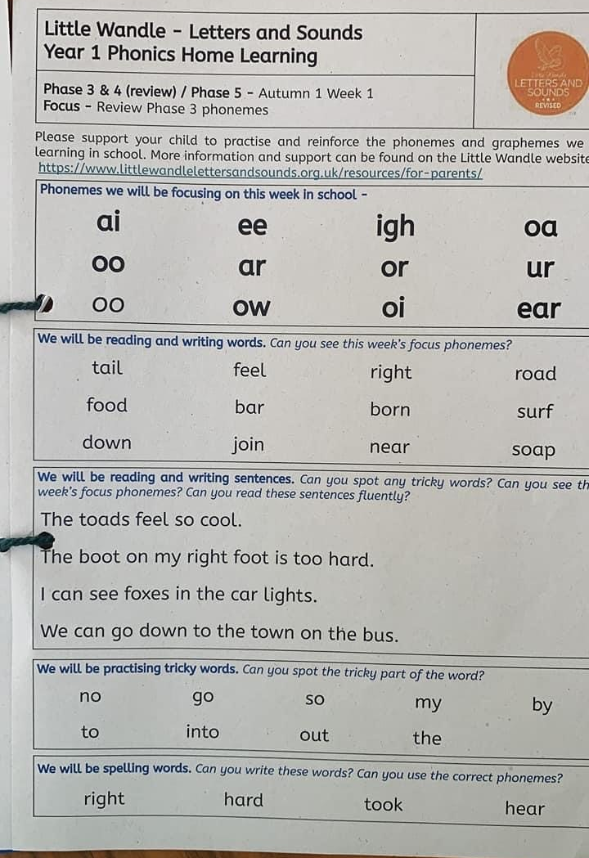
Homework

Slide 21
How to Support at Home
Complete all homework tasks (ideally by Monday)- please feel free to adapt the work to suit your child.
Read daily
Phonics flashcards
Reading in the environment/using maths in daily life/ writing for a purpose
Handwriting
Spelling- Year 1 Common Exception Words
Look on the school website- I have uploaded some support documents
Use any additional resources I send home
Be positive about school!

Slide 22
Behaviour
In Year 1, we move away from the “shooting star system” that is used in EYFS, and move to the system used by the rest of the school- “Good to be Green”.
Each child starts the day on green, and they have the opportunity to move up to Gold for exceptional behaviour/effort/work/kindness.
If they are not behaving in line with our class rules, they will receive a verbal warning. They receive 3 verbal warnings, and if they continue to have issues they are given a “blue card” (This is NOT put on display) and they may be given a time out to reflect on their behaviour. If they continue to have problems, they would receive a “red card”, at which point they would be sent to a member of SLT. The children, of course, are given plenty of opportunities to end the day on green!
PLEASE NOTE: if I have any concerns about your child’s behaviour, I will communicate this with you immediately!
Rewards:
If your child ends the day on Gold, they will be given a sticker.
House points.
Prayer Bear
Class Marble Jar
Role of Honour
Special Stickers
Prize Box
Merits

Slide 23
Parent Fund Donations
I have lots of lovely activities planned for this year, however buying resources to make these activities possible can cost a lot of money, and in order to be able to run in a more EYFS- friendly way and provide enriching experiences, we do ask for contributions to the parent fund. This money will be spent directly on supporting your children’s learning and will pay for activities such as:
Ingredients for met to make “poo” for our Science poo investigation in Autumn 1.
Food/materials for a Science senses “Taste Investigation” in Autumn 1.
Foods from around the UK for a Geography Tasting activity in Autumn 1.
Contributions to this fund are really appreciated HOWEVER I recognise that times are tough and please do not feel pressured to contribute if you are not able to.
The donations are £1 a week- so for a 14 week term (September- Christmas), this would cost £14!

Slide 24
School Trips
This year, the school are hoping to make the most of a year with less restrictions, therefore we have mapped out the school trips that the children will have the opportunity to go on.
Autumn Term- Welly Walk
Around November time (I will let you know a date as soon as possible), we will go on a Welly Walk in our local area, to Napsbury Park. The children will wear some welly boots and we will be having a look at the seasonal changes we can spot. All parents are invited to attend this with us, it will be around an hour or so in the morning, and this will not cost anything!
Spring Term- Kite Flying
In the Spring term, we have a brand new trip to go on! We will go to Dunstable Downs and fly kites that we have made together in school. The only cost for this trip should be the coach fee.
Summer Term- We’re going to the zoo!
In the Summer term, we will be going on our main school trip of the Year, to Paradise Wildlife Park in Broxbourne. This is a really lovely trip, which the children really enjoy, and gives them the opportunity to see a range of animals that we will have learnt about in Science and Geography, and to see some dinosaurs too!
We want to let you know in advance as we appreciate that finances may be difficult this year, particularly for those of you that have several children in the school. Please let me, or the school office, know if you have any concerns.

Slide 25
Authorised Adult- Google Form
You all received an email from the school office with a Google Form to complete to inform us of any adults that are authorised to collect your child.
Please ensure you have filled this out. If an adult comes to collect your child and they are not on this list, I will not be able to dismiss them. If you feel that your child is likely to regularly go home with another child’s family, if you are running later for example, add them to the list- you can have more than 4!
If your child is going to be going home with another child for a play date, please ensure you let me know. We are really trying to push for written permission this year- just a brief note that you can hand to me in the morning to let me know.
This is to ensure the safety of your child.

Slide 26
Thank you all for coming, and I am looking forward to a wonderful year, working with you and your lovely children!

