Slide 1
St Bernadette Catholic Primary School
Catholic Academy Trust Consultation
Wednesday 18th October 2023

Slide 2
Welcome and Introductions

Slide 3
Stephen Wheatley - CEO pof ASCAT
Adrienne Leggett - The Academy implementation officer
Patricia O’Donnell - Headteacher of St John Fisher

Slide 4
Foreword from the Cardinal…
“Now we are living through times of considerable hardship for many ….. We have to see, be clear, and readjust. This means taking difficult decisions, marked by realism, about resources. In such circumstances it is right to look for economies that can be achieved by structures of cooperation, between schools within the same locality and within the wider family of schools. This is not an enforced 'master-plan', as you well know. It is a measured and appropriate response to the reality we face. The alternative, individual schools in isolation, will lead not only to conflict but also to the decline that eventually accompanies isolationist policies. “
Extract from Cardinal Nichols recent address to the Diocese of Westminster
Headteachers Conference February 2018

Slide 5
Our Proposal….
Following a period of collaboration, support and work together over the past 2 years the leadership team and Governors of St Bernadette believe that the time is now right to convert to an Academy and expand the All Saints Catholic Academy Trust (ASCAT)
The existing ASCAT is currently comprised of the following schools:
Saint Joan of Arc Catholic School Holy Rood Catholic Primary School Divine Saviour Catholic Primary School St John’s Catholic Primary School | St John Fisher Catholic Primary School St Thomas More Catholic Primary School St Albert the Great Catholic Primary School JFK Catholic School

Slide 6
Our decision was based on the following:
The want to ensure a secure future for the community of St Bernadette school over the years to come
Provide ourselves with a more strategic approach to working with other schools
Retain our excellent staff by providing them with more opportunities for progress further in their career
Have a voice in the changes that need to be implemented in education and the financial implications this has on schools
All these things will have a positive impact on the educational experience of the children in our community

Slide 7
The Diocesan Vision for the CAT programme
Develop CATs across the Diocese to protect, secure and develop Catholic education for generations to come;
To be inclusive and open to all Schools in the Diocese;
To promote strong bonds of collaboration and accountability improving educational outcomes and opportunities for all children, staff and families in our schools;
Create opportunities to develop the professional expertise of staff to aid the retention and development of the best staff within the Trust
Schools will maintain and further develop existing links and partnerships with other Schools.

Slide 8
What will not change….
The individual ethos of our School
The staff team: Headteacher, senior leaders, teachers, teaching assistants, school support staff
Our School Uniform and Curriculum
Governors will continue to serve on a Local Governing Body;
The School will remain part of the co-ordinated admissions process through the LA
The School will not select any students on the basis of their aptitude or ability
The current admission policy will continue to apply; Local Governors will retain the ability to set this
The timings of the current school day
The terms and conditions of employment for staff will remain unchanged.

Slide 9
What will change….
The legal status and governance arrangements for the schools;
The current Governing Body will become a Local Governing Body who are accountable the ASCAT Board of Directors
The Trust Board will have strategic oversight for the finance, standards and the physical environment of each individual academy within the Trust
A CEO is in place who will be accountable to the Trust Board and will lead the strategic development of the Trust
Funding will come direct to the School from Central Government, rather than via the Local Authority

Slide 10
Governance Structure
Members (5)
Archbishop, Auxiliary Bishop, Vicar General or A Diocesan Trustee, RCDOW Director of Education, RCDOW Financial Director
Trust Board (6)
Six Catholic Foundation Directors appointed on a skills basis and a Catholic Executive Officer accountable to the Board
Local Governing Body
Formed from existing Governing Bodies, responsible for day to day running of schools with Headteacher

Slide 11
Organisational Structure
Members (5)
Trust Board (6)
Catholic Executive Officer
Chief Financial Officer
Academy Headteachers
Local Governing Bodies
(7 FG, 2 Parent, 1 staff & 1 community)

Slide 12
The Benefits for our pupils….
Improved educational opportunities and outcome by sharing best practice across the Trust, leading to improved practice (teaching, curriculum, pastoral) in each school
Assistance with financial management and reducing financial risk to schools within the Trust by seeking efficiencies at a time of growing financial pressures
Benefitting from the advantages that CATs enjoy in capital development, e.g. not paying the VAT on capital developments (we currently pay VAT @ 20%)
Through the above we help to keep schools afloat and solvent; ploughing savings back into the classroom
Improved professional development opportunities and career pathways for staff;
Improved retention and development of the best Catholic school staff, teachers and Leaders

Slide 13
Other Benefits….
Reduce financial risk to schools within the Trust by seeking efficiencies at a time of growing financial pressures;
Improved professional development opportunities and career pathways for staff;
Improved retention and development of the best Catholic school staff, teachers and Leaders;
Consistent clear, robust and effective Governance at Trust and Local Governing Body levels;
Protect, secure and develop Catholic education across the Diocese.

Slide 14
Why now….
An opportunity to work with the Diocese and other Catholic schools to shape and preserve the future of Catholic Education
A desire to be innovators and play a part in the shaping/ setting of the local agenda;
This is the Cardinal’s wish and vision for Schools in the Diocese
There has been and will remain severe pressures on School budgets
The Global pandemic has exacerbated the financial pressures on central government which are likely to be shared across all public sectors including schools
Concern nationally and locally about falling rolls – of particular concern in the Catholic sector
Reductions in capacity of Local Authorities to provide adequate resources to support schools
Academies as part of collaborative Trusts remain a central plank of current national education policy

Slide 15
Next Steps….
Consultation period open for comments/questions. Concludes on 20th October
Results will be reported to the School’s Governing body in December
Governors to review consultation results and decide whether or not to proceed
If Governors approve conversion next steps are
to hold a TUPE consultation with staff
transfer land, existing service level agreements and contracts to the Trust
Introduce common platforms for management and finance systems across the Trust
Proposed conversion date is 1st April 2024 subject to HCC approval.

Slide 16
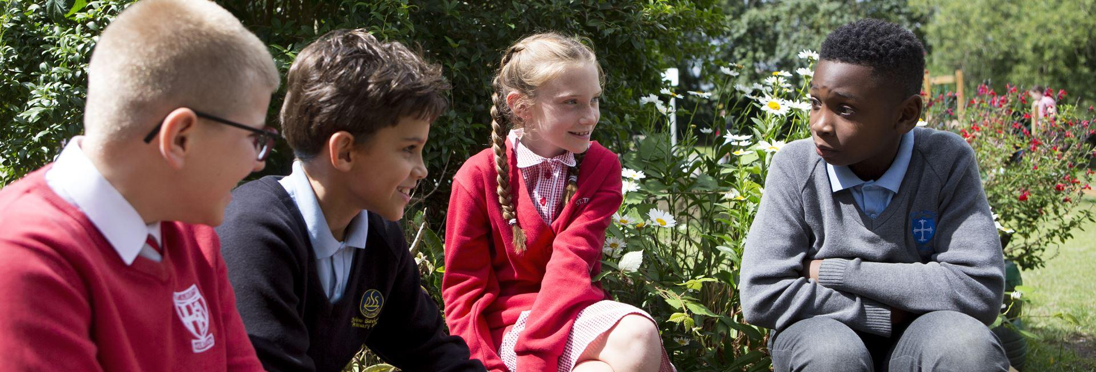
Any Questions….

Slide 17
Thank you for your time and contributions

