Slide 1
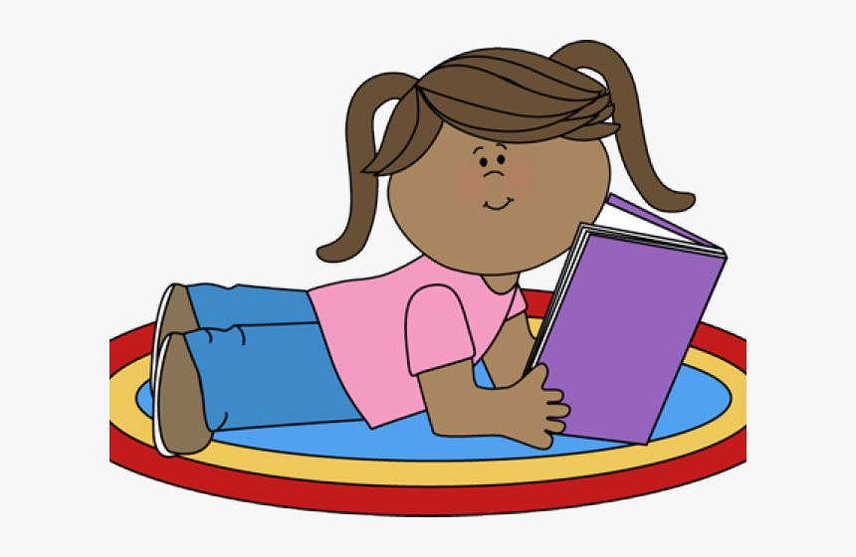
Why is it important to read for pleasure?
Research has found that reading for pleasure boosts comprehension, vocabulary and attainment- and benefits children beyond the Literacy curriculum.
Books feature more rare words than any other form of spoken or written media. This supports vocabulary development.
Reading comprehension is is promoted more strongly by leisure reading of books, whilst building comprehension makes it more likely that a child will read for pleasure.
Reading for pleasure has been found
to improve children’s maths. There is a strong positive link between reading for pleasure and cognitive outcomes.
Reading for pleasure has been
linked with greater general knowledge.
Surveys have found that children
that read for pleasure have better mental wellbeing than their peers.
100 Books to Read
Before You Leave St. B
This year, we are introducing a new initiative to support and promote a love of reading- “100 Books to Read Before you Leave St B”. The focus of this challenge is to encourage the children to read for pleasure.
Did You Know?
Reading for pleasure can increase empathy, improve relationships and improve wellbeing throughout life.

Slide 2
100 Books to Read
Before You Leave St. B
What is “100 Books to Read Before You Leave St. B” all about?
TES interviewed primary school teachers and asked them to vote for which 100 fiction books they thought the children in their class should read before they leave primary school.
TES compiled the results into a list, ranked from the most popular answer to the 100th.
In our school office entrance area, there is a display showing all of the 100 books on the list. There is also a booklet available which gives a brief overview of each book so you can see which one you are most interested in reading next.
Take a look at the display here- are there any books that you have already read? Are there any books that you feel excited to read?

Slide 3
100 Books to Read
Before You Leave St. B
How does the challenge work?
Each child in the school has been given their own Reading Journey Folder. This will follow them all the way through from Reception to Year 6. This folder contains their front cover, instructions on how to complete the challenge, and a checklist of the books. Once the children have completed a book review for each book, these will be filed within this folder.
These folders will stay in school.
How to take part in the challenge:
Find a book from the list- look in the office, your classroom, the school library or your local library.
Read the book.
Complete a book review and file this in your Reading Journey folder- book reviews can be found in the office, your classroom, the library, or on Google Classroom to print.. Make sure to number the book review at the top!
Tick the book off on the list and date it.
Return the book, choose a new book and repeat!
Some of the books you will read in school as a class, others you will be able to choose to read them at home or at school.
You can take the book review templates home to complete, or you can complete them as part of your morning work, or as a break time or lunch time activity.

Slide 4
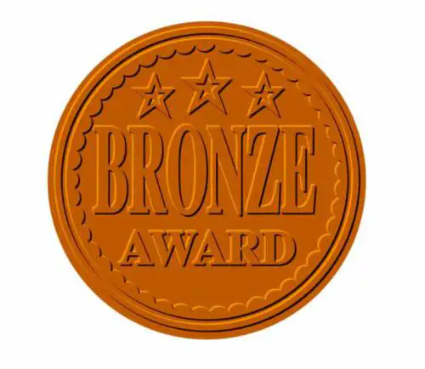
100 Books to Read
Before You Leave St. B
Awards
Every time a child has reached a milestone (25 books, 50 books, 75 books, 100 books), they will bring their Reading Journey folder to Miss Broom to check.
Once Miss Broom has verified that they have met that milestone, the children will receive an award.
100 books
75 books
50 books
25 books
What are the rewards?
Bronze- 25 books; Headteacher’s Merit, Bronze Reader Sticker and certificate.
Silver- 50 books: Headteacher’s Merit, Silver Reader Sticker and certificate, and a bookmark.
Gold- 75 books: Headteacher’s Merit, Gold Reader Sticker and certificate, and a story time pack (hot chocolate and a new book!)
Completed- 100 books: Headteacher’s Merit, a reading challenge trophy, a place in our Reading Hall of Fame, and a voucher to buy some new books!

Slide 5
100 Books to Read
Before You Leave St. B
Questions and Answers.
Q. My child is in Key Stage 2 and there are lots of books they have already read, do they have to re-read them?
No! If your child has already read some books on the list, they do not need to re-read them, but they do need to complete a book review for it to count.
Q. My child is in Reception and they aren’t able to write yet, can I write the book review for them?
Yes! For children in Reception and in the early stages of Year 1, parents can scribe for their child, but it should be their child’s words.
Please note that book reviews should be completed to a good standard and should not be rushed- if it appears that a child has just rushed through to complete reviews to try and reach a milestone, without having taken the time to fully read the book and reflect on it, then their reviews will not be counted.
PLEA
If anybody has any books from this list at home that their child has already read and they no longer want, we would be very grateful for any donations! Please hand them either directly to Miss Broom, or to the office and let them know that it is for the 100 Book Challenge.

Slide 6
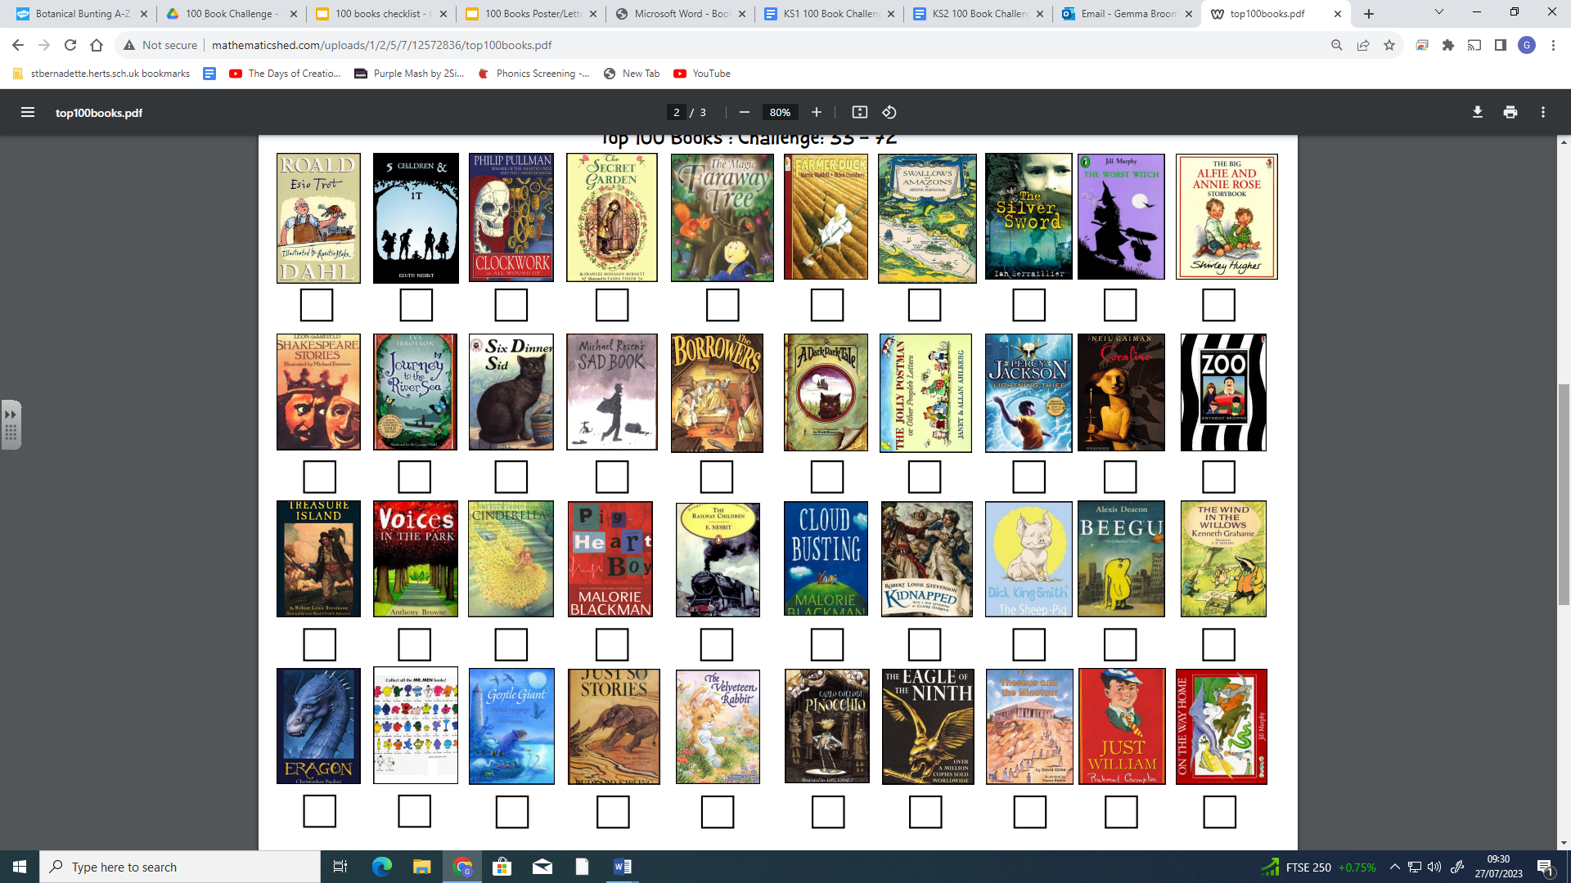
100 Books to Read
Before You Leave St. B

