Slide 1
Welcome Year 2 Parents/Carers
KS1 SATS Information Evening

Slide 2
Aims of the session:
to give an overview of the changes to the National Curriculum and the way assessment is carried out
to provide information about the new end of Key Stage 1 SATs
to provide ideas about how to support your child at home

Slide 3
The New National Curriculum
the New Curriculum has been statutory for all children from 1st September 2015
it is a mastery curriculum where depth of learning and understanding is favoured over ‘pace and race’
there are fewer objectives which are repeatable across the curriculum and in different contexts
children are not expected to go beyond the learning objectives for their year group
we are teaching for consolidation, application and depth of understanding

Slide 4
Example of Greater Depth in Maths
Grace uses a £2 coin to buy a can of drink which costs 85p. She is given four coins in change.
Find all the possible combinations of coins she could have been given.

Slide 5
Changes to KS1 SATs 2017
with the removal of levels, interim teacher assessment frameworks have been developed
the framework exemplifies:
‘Working towards the expected standard’
‘Working at the expected standard’
‘Working at greater depth within the expected standard’
children need to demonstrate attainment of ALL the statements within the standard and ALL of the statements in the preceding standard(s)
The children will be marked according to these 3 statements through teacher assessment using the interim criteria. The SATS will go towards providing evidence that the children are meeting the expected standard.

Slide 6
At the end of the year your child will not be given a level or a score. Instead they will be assessed as being:
Working towards the expected standard’
‘Working at the expected standard’
‘Working at greater depth within the expected standard’

Slide 7
Reading
The reading test will consist of 2 papers.
Paper 1 will combine reading prompts alongside the questions. The questions will relate to the reading prompt at the top of each page.
Paper 2 will consist of a reading booklet containing 2 different texts and a separate answer booklet containing questions based on the texts.

Slide 8
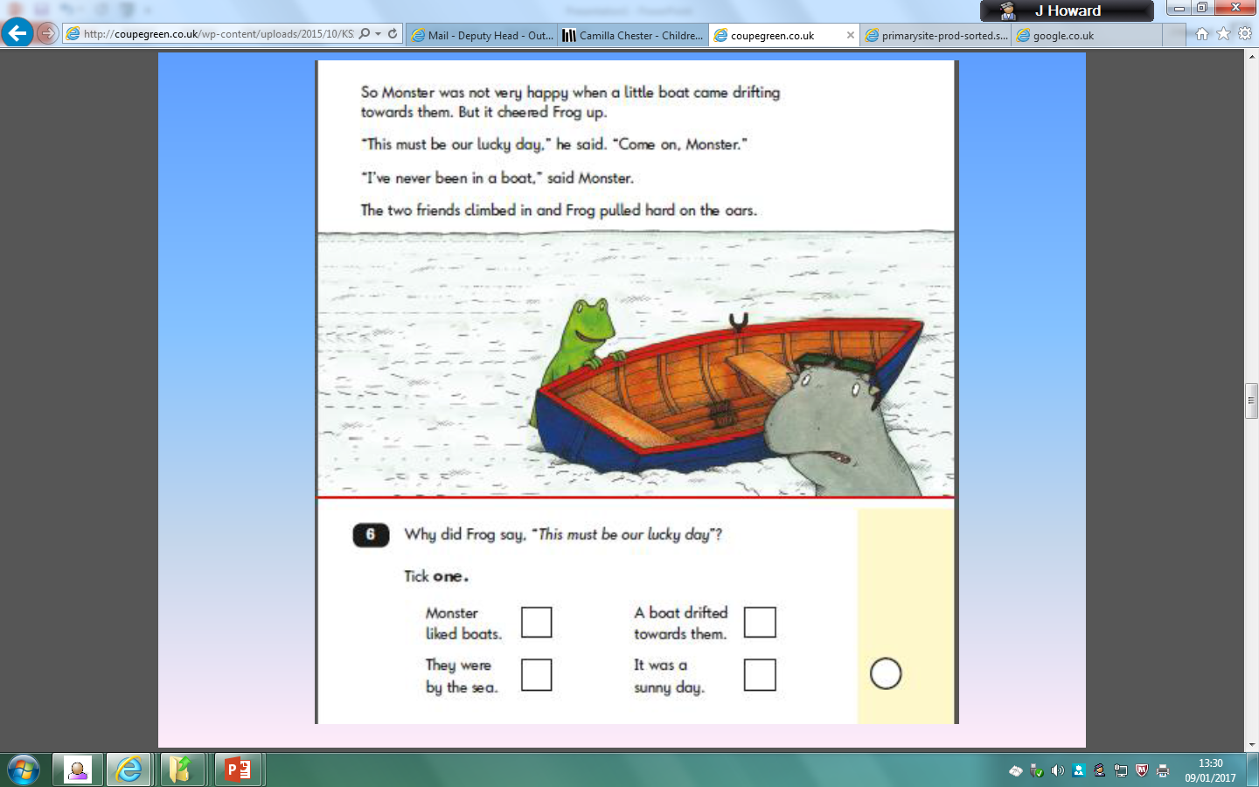

Slide 11
Changes to KS1 SATs for English 2017
Reading:
all children to take both reading tests
greater emphasis on comprehension (inference and deduction)
mixture of text genres (unrelated) of increasing difficulty
vocabulary knowledge an important factor
children are expected to read with fluency and pace
teacher assessment forms the final judgement

Slide 13
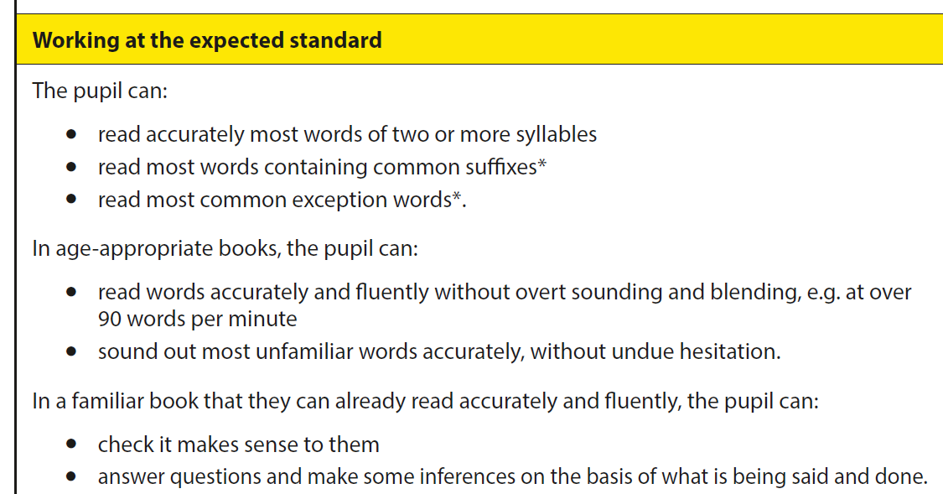

Slide 15
Changes to KS1 SATs for English 2017
Writing:
there is a new Grammar, Punctuation and Spelling Test in 2017 where the emphasis is on technical aspects of grammar
the written task has been removed and writing will be assessed through teacher assessment
exemplification materials to support Teacher assessment have recently been published by the STA
greater emphasis on handwriting and spelling

Slide 16
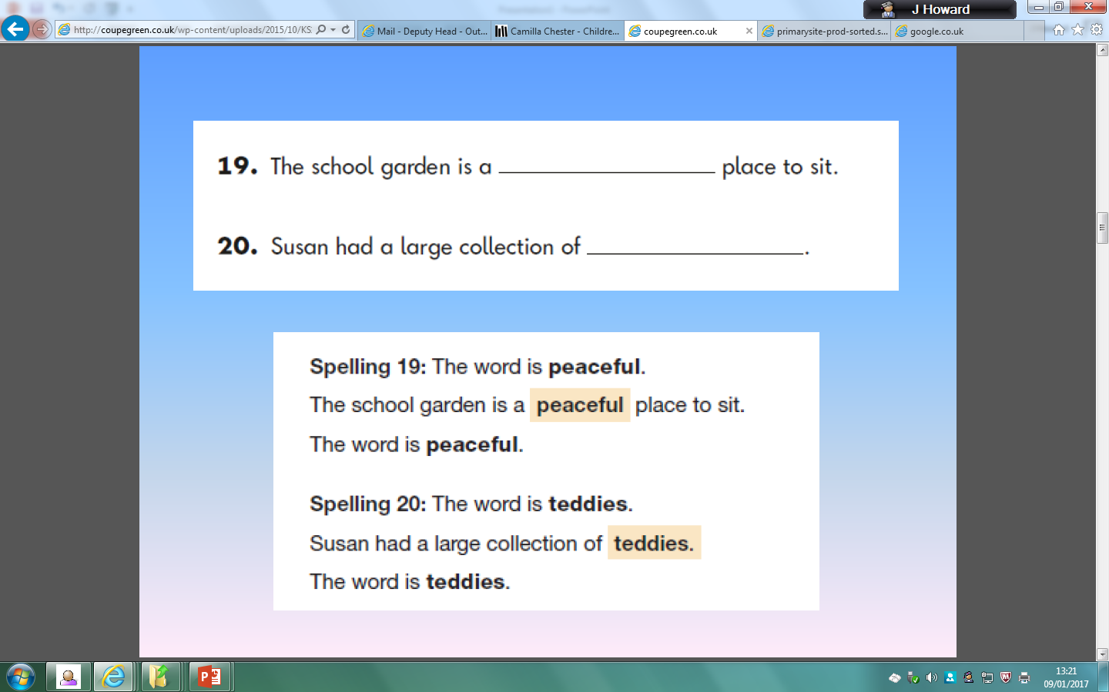

Slide 22
Changes to KS1 SATs for Maths 2016
the maths tests comprise of two components: an arithmetic paper and a reasoning paper
the arithmetic paper is designed to assess children’s confidence and mathematical fluency with whole numbers, place-value and counting
the reasoning element assesses children’s mathematical fluency, problem solving and reasoning skills

Slide 23
Paper 1: arithmetic
Addition: 36+24=
Subtraction: 39-8=
Multiplication 3x3=
Division: 35 divided by 5=
Multiple step calcualtions: 15+3+3=
Missing numbers: 50 - ____ = 20
Fractions: ¼ of 20=

Slide 28
Making a judgement
tests at the end of KS1 (and KS2), will report on scaled scores
children will receive a ‘raw score’ and this will be converted into a ‘scaled score’
the expected standard will always be set at 100
children with 100 or more will have met the expected standard and pupils who score below 100 will not have met the standard
teacher assessment is reported but teachers must have a broad bank of evidence to support their judgements

Slide 29
Implications for our children
children will know that they are doing assessment tasks however they shouldn’t feel anxious or concerned
We want them to feel prepared
judgements will help their next teacher to plan the appropriate provision
focus is on what they ‘can’ do
a mastery curriculum will ensure that they have solid knowledge and understanding

Slide 30
Ways to support your child at home with Reading
question children about vocabulary and use as wide a vocabulary as you can when discussing stories (reading and writing)
ask children to make predictions based on what they have read
ask how characters might be feeling and why
encourage children to summarise what they have been reading
Attend reading meeting

Slide 31
Ways to support your child at home with Writing
ensure that children start in the right place when forming their letters
insist that writing stays on the line and that letters are positioned correctly
remind children to use capital letters and full stops correctly
encourage children to write more complex sentences (adding conjunctions to join ideas and explain ideas eg. ‘Jack was crying because his mother was furious with him’ or ‘Jack ran away from the angry giant quickly so that he could get back down the beanstalk’)
writing a daily diary is a great way to develop their skills

Slide 32
Ways to support your child at home with Maths
lots of counting forwards and backwards in 1s,2s,3s,5s and 10s
focus on subtraction, mentally and practically, with money
telling the time
identifying 2D and 3D shapes and using the correct vocabulary of faces, edges and vertices
practical measuring using grams, kilograms, millilitres, litres, centimetres and metres
applying learning in maths to lots of different and real contexts

Slide 33
Useful Websites
www.bbc.co.uk/schools/numbertime - Number Time activities which support the Numeracy Framework for Reception and Year 1
http://www.ictgames.com/resources.html - A wide range of literacy and numeracy games to reinforce concepts covered in Reception and KS1
http://www.bbc.co.uk/schools/digger/5_7entry/5_7.shtml - Digger and the Gang literacy and numeracy activities aimed at 5 - 7 year olds
http://www.crickweb.co.uk/ks1numeracy.html - 15 interactive activities covering a range of mathematical skills, aimed at children in Years 1 and 2
http://www.coxhoe.durham.sch.uk/Curriculum/Numeracy.htm#Links%20to%20Useful%20Sites
http://www.woodlands-junior.kent.sch.uk/maths/index.html
http://resources.woodlands-junior.kent.sch.uk/interactive/literacy2.htm
http://www.bbc.co.uk/bitesize/ks1/ The BBC website is being updated but there are a range of English activities and games (Reading and Writing) you can access.
http://www.crickweb.co.uk/ks1literacy.html Range of English activities and games.

Slide 34
Any Questions …
Please feel welcome to contact us in the usual ways to ask any questions.
Thank you for coming!

