Slide 1
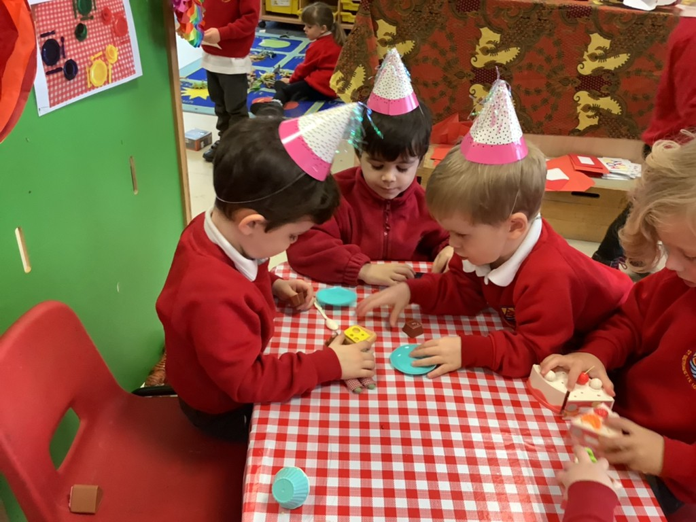
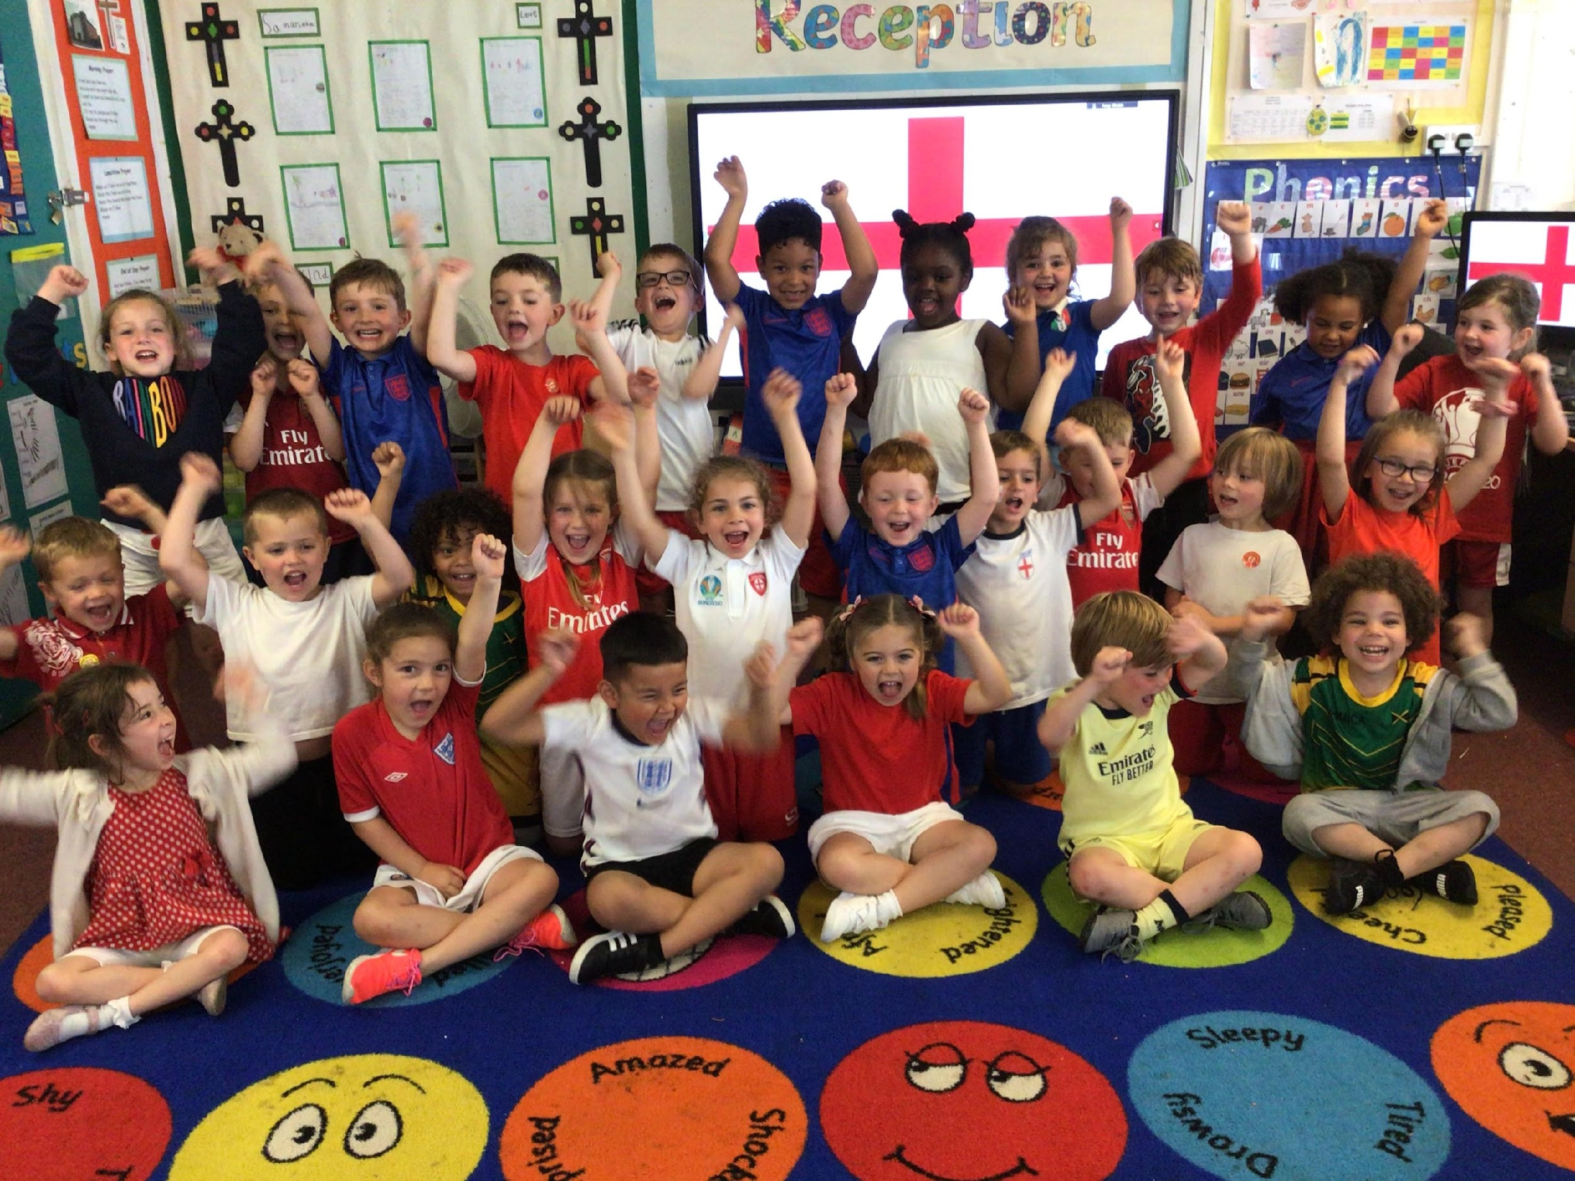
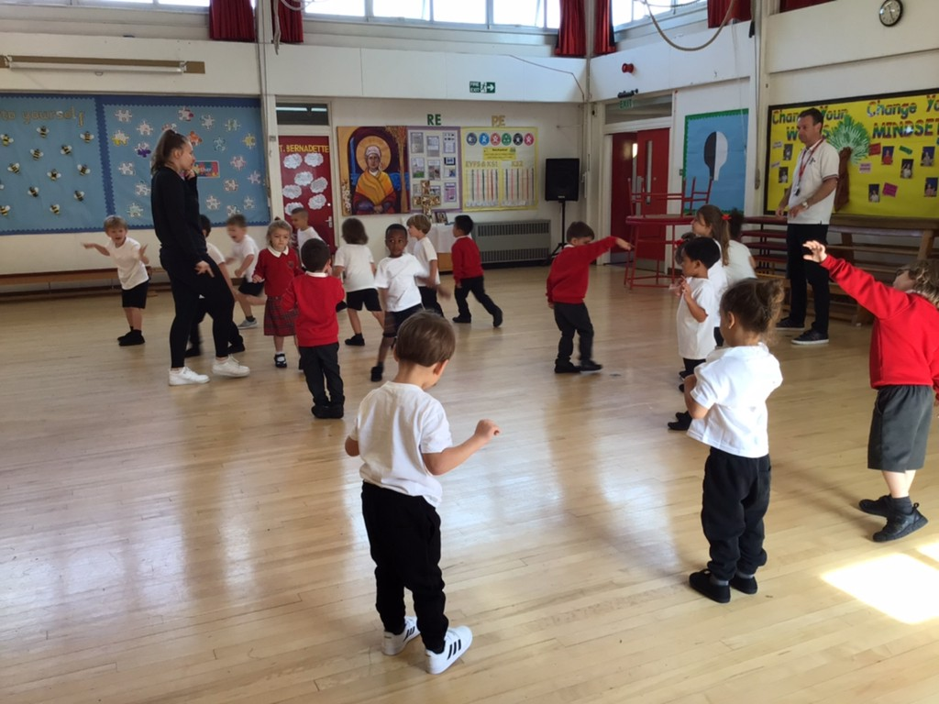
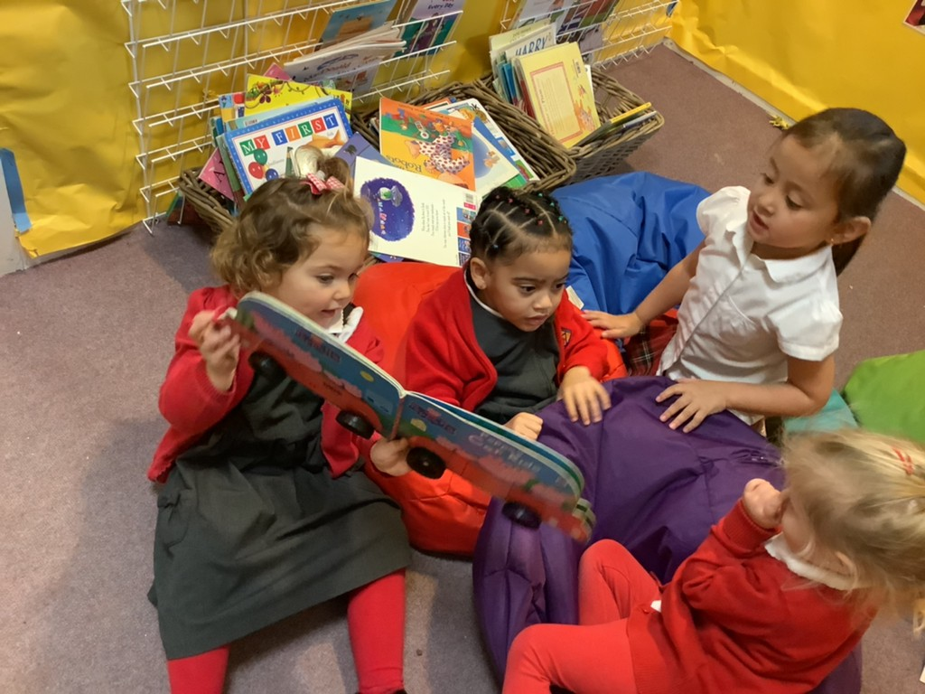
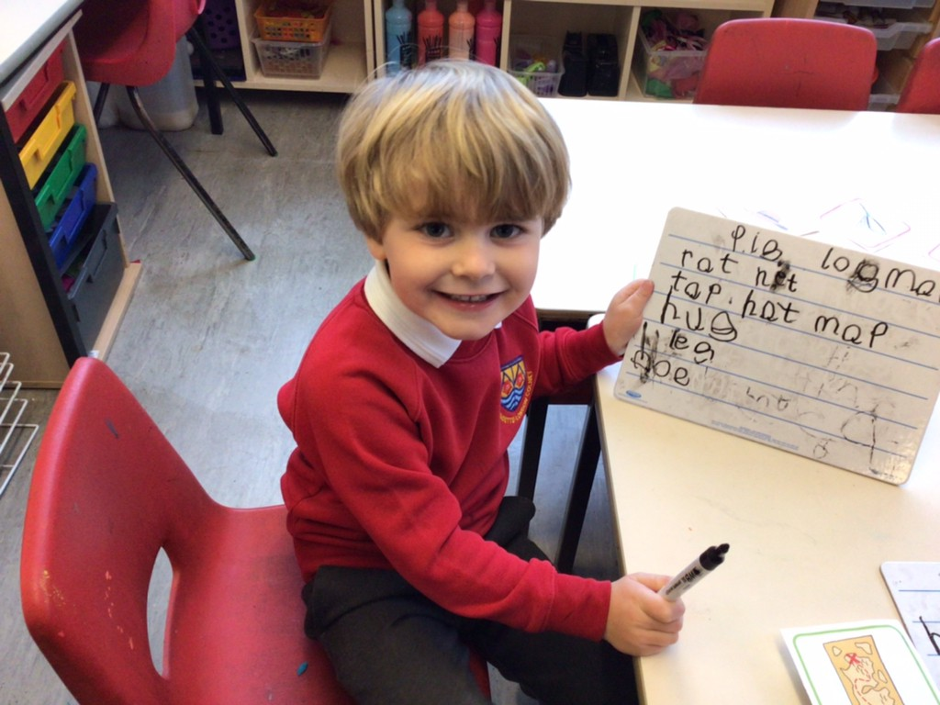
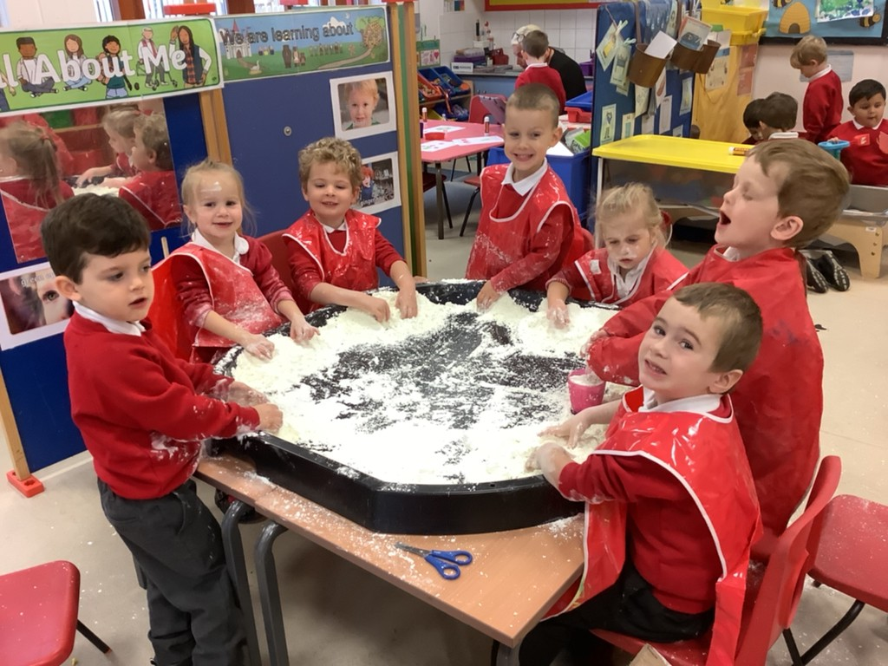
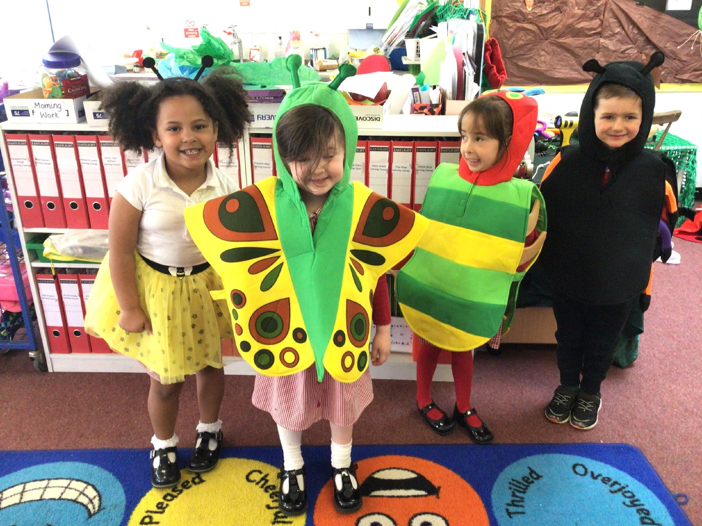
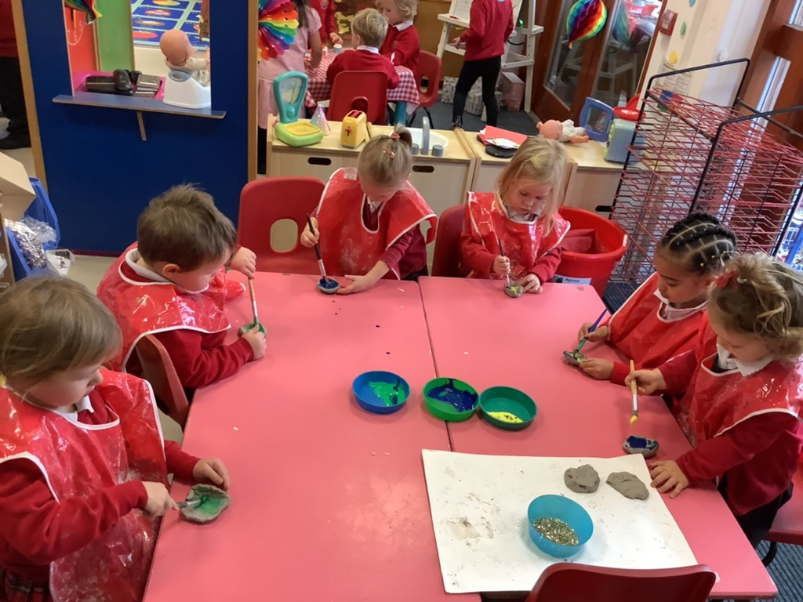
2022-2023
St Bernadette Catholic Primary School
“Learning to grow in knowledge, faith and love through friendship with Jesus and Mary.”
Welcome Booklet for new Nursery Children
Birthday Tea Party
Football World Cup
PE Lessons
Sharing Stories
Writing Words
Messy Play!
Minibeast Role Play
Diwali ‘Diya’ Lamps
Notes:
Welcome to St Bernadette’s & hello
One form entry school ranging from Nursery to Y6
Plan for the morning: talk about our school and the EYFS, ending in opportunities for questions and a tour of our outdoor areas

Slide 2
2022-2023
St Bernadette Catholic Primary School
“Learning to grow in knowledge, faith and love through friendship with Jesus and Mary.”
Our Ethos
Our School is proud of its strong community. We value our partnership with parents, parishes and the wider community.
We are a school and church community, a family, promoting core Gospel values of compassion, respect for self and others, responsibility and honesty.
Our blend of traditional values, combined with creativity and innovation, offers a rich environment for progress. We believe that every child can succeed in life if challenged and inspired appropriately.
We share a vision for each child to be cherished and have the best opportunities for an excellent education and fun-time in these formative years, to be a place where we help to make long-lasting magical memories through a creative inspiring curriculum. We encourage the full potential of every person by providing a unique and sacred learning environment witnessing to the person of Christ at the centre of every aspect of school life. We seek to build positive relationships with parents and others we work with, to provide a service to society preparing children as good citizens. We aim to foster a love of learning in our children and to allow every child to work to the best of their ability. We strive for excellence in all we do.
Notes:
We are a Catholic School so a part of our school ethos is instilling the Gospel Values within the children
Despite having religious opportunities within our school days, I want to stress that it is not necessary for you/your children to follow the Catholic faith

Slide 3
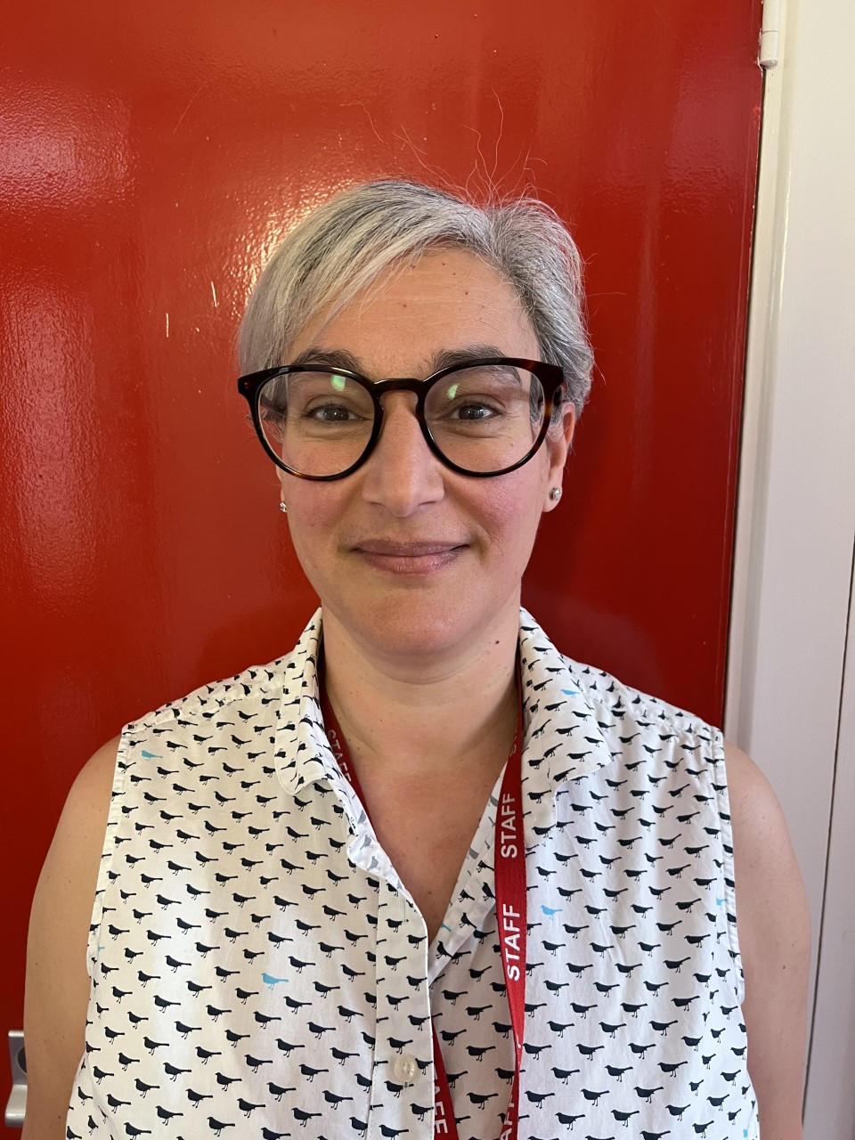
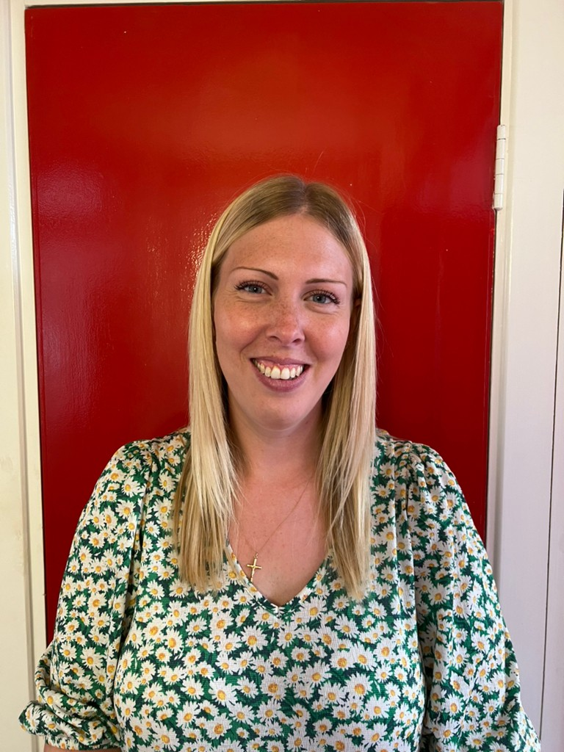
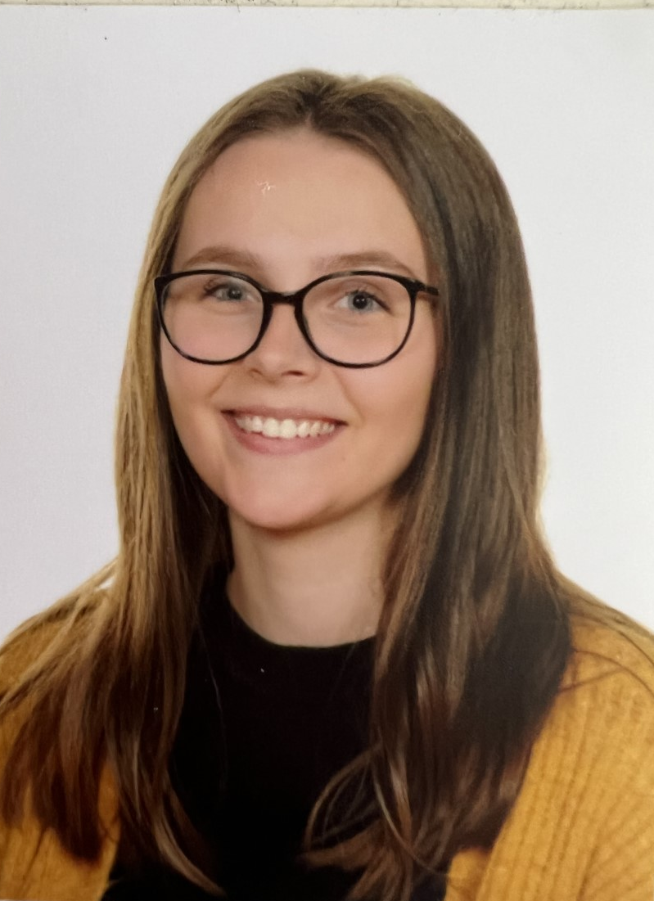
2022-2023
St Bernadette Catholic Primary School
“Learning to grow in knowledge, faith and love through friendship with Jesus and Mary.”
Meet the Team
Mrs Campanella
(Early Years Practitioner)
Miss Weston
(Class Teacher)
Miss Webb
(Early Years Phase Leader & Reception Class Teacher)

Slide 4
St Bernadette Catholic Primary School
“Learning to grow in knowledge, faith and love through friendship with Jesus and Mary.”
EYFS Curriculum
The Early Years Foundation Stage (EYFS) sets standards for the learning, development and care of your child from birth to 5 years old.
All schools and Ofsted-registered early years providers must follow the EYFS, including childminders, preschools, nurseries and school reception classes.
Prime Areas of Learning
Communication and Language |  | Physical Development |  | Personal, Social, Emotional Development
Specific Areas of Learning
Literacy | Maths |  | Understanding the World |  | Expressive Art and Design
Notes:
Unlike children in the older years, the EYFS curriculum is very different
We do not have subjects, instead we plan activities that link to 7 areas of learning; 3 Prime Areas and 4 Specific Areas
It is the Prime Areas that are the fundamentals in order for the Specific Areas to work
These areas essentially are similar to subjects (go through the links/what they entail)

Slide 5
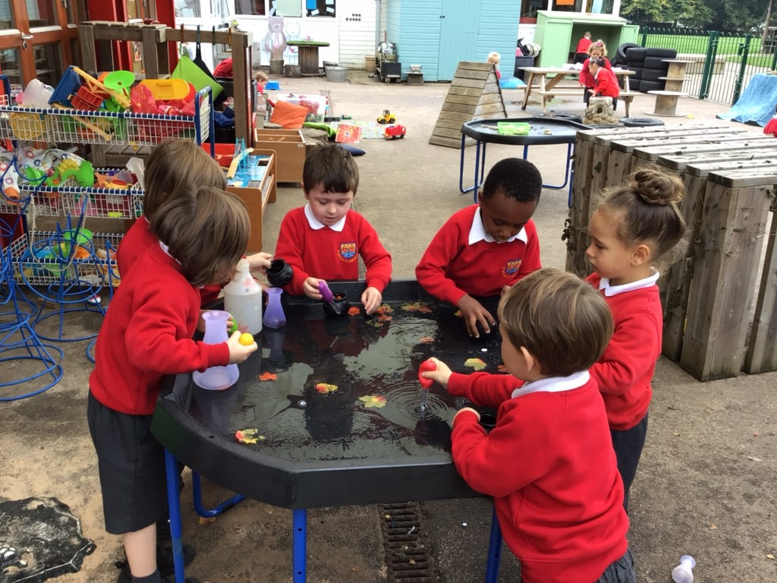
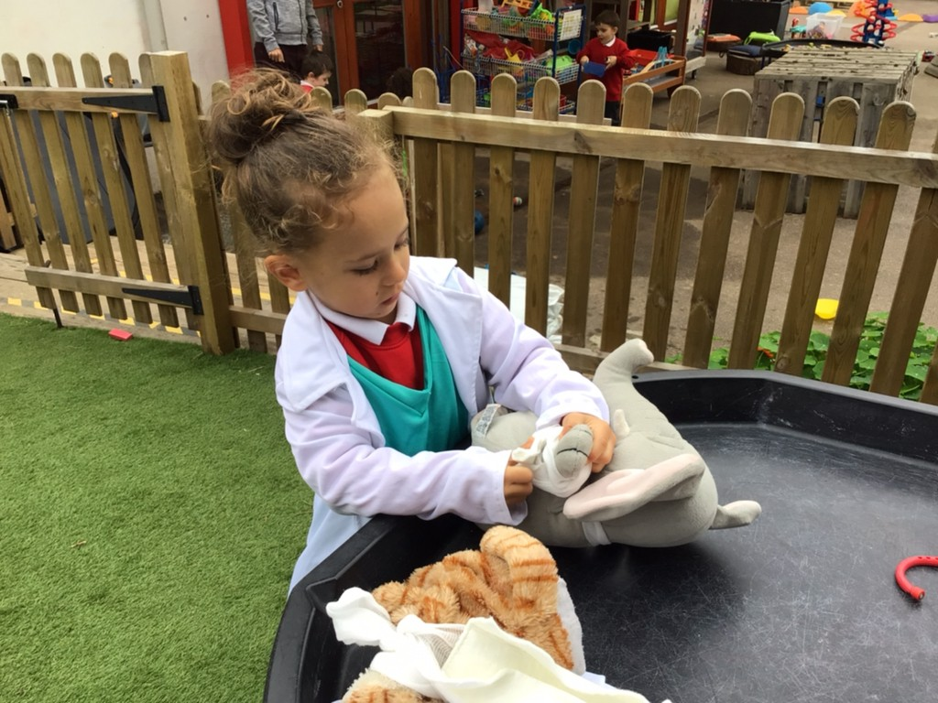
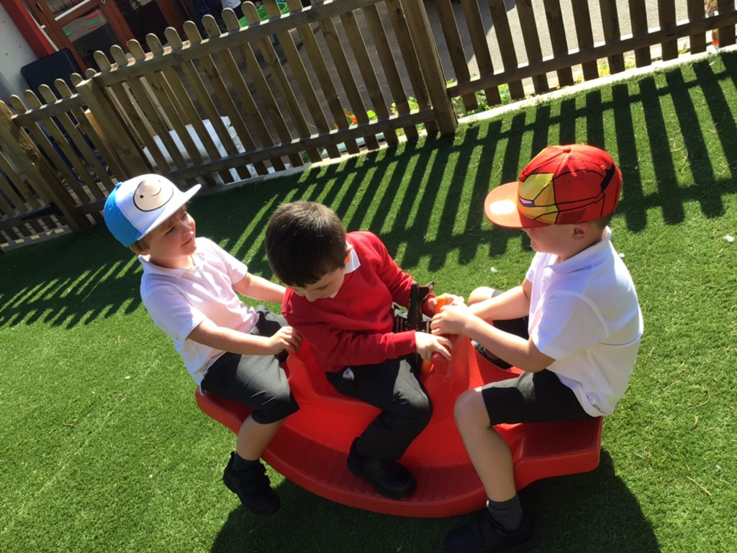
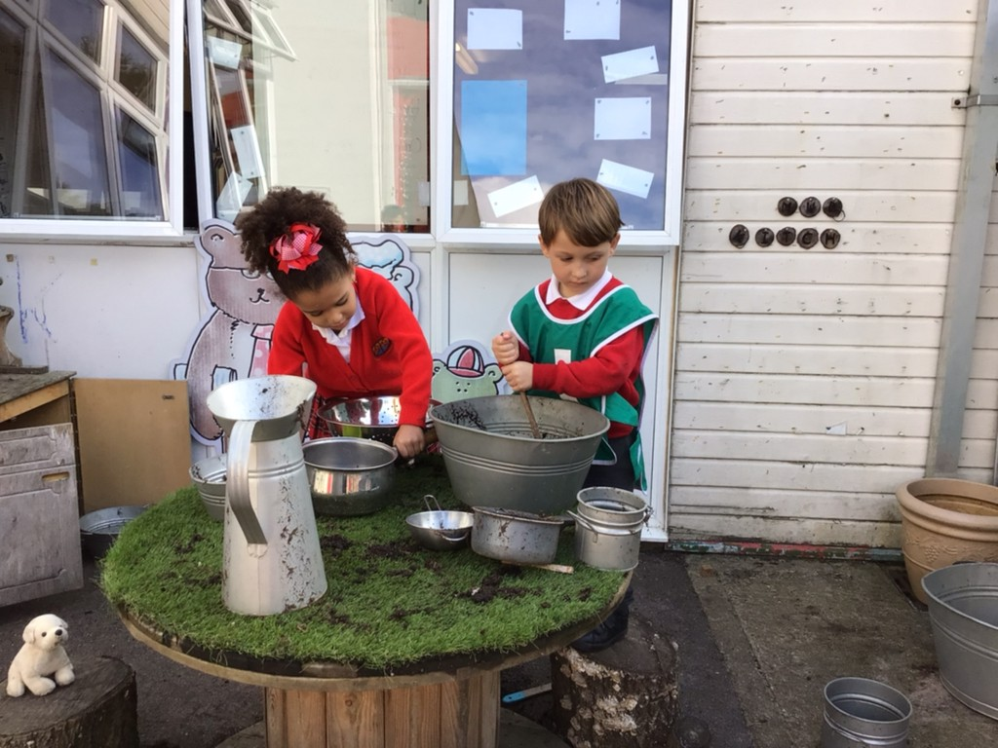
St Bernadette Catholic Primary School
“Learning to grow in knowledge, faith and love through friendship with Jesus and Mary.”
EYFS Curriculum
We are very fortunate here at St Bernadette to have lots of grounds for the children to use. In the Early Years, we do the majority of our learning in our indoor and outdoor area.
Potion Making
Vet Role Play
Building Relationships
Mud Kitchen
Chinese New Year

Slide 6
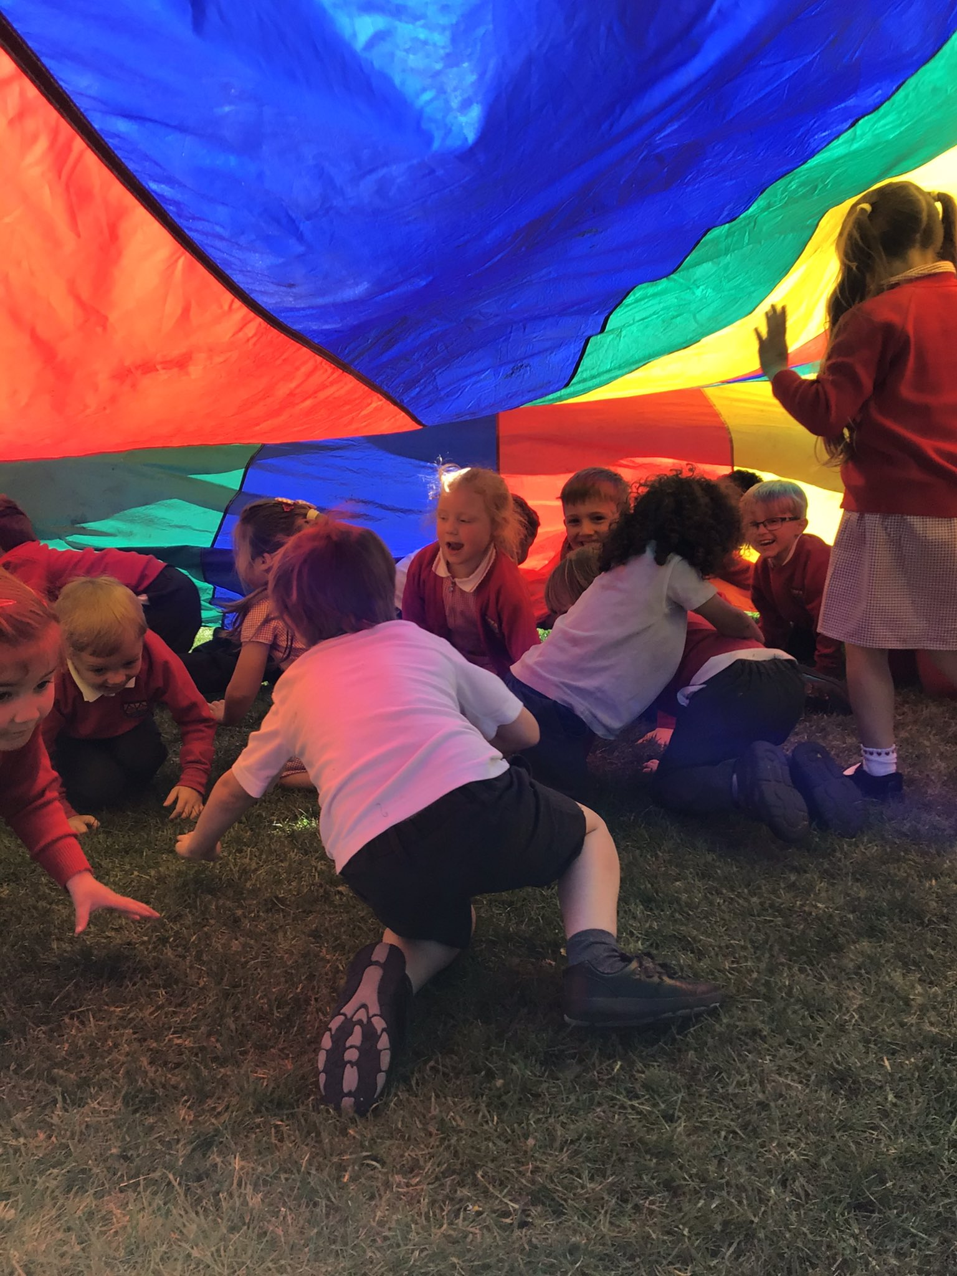
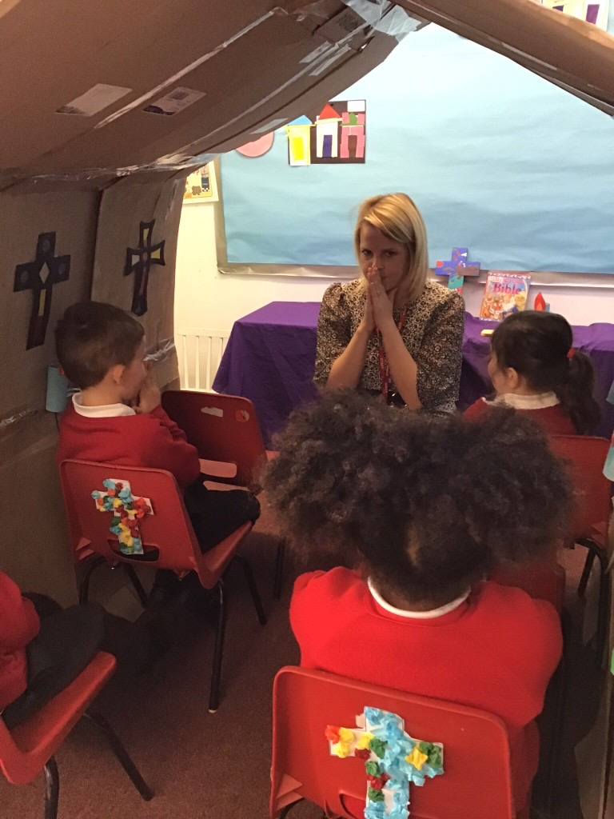
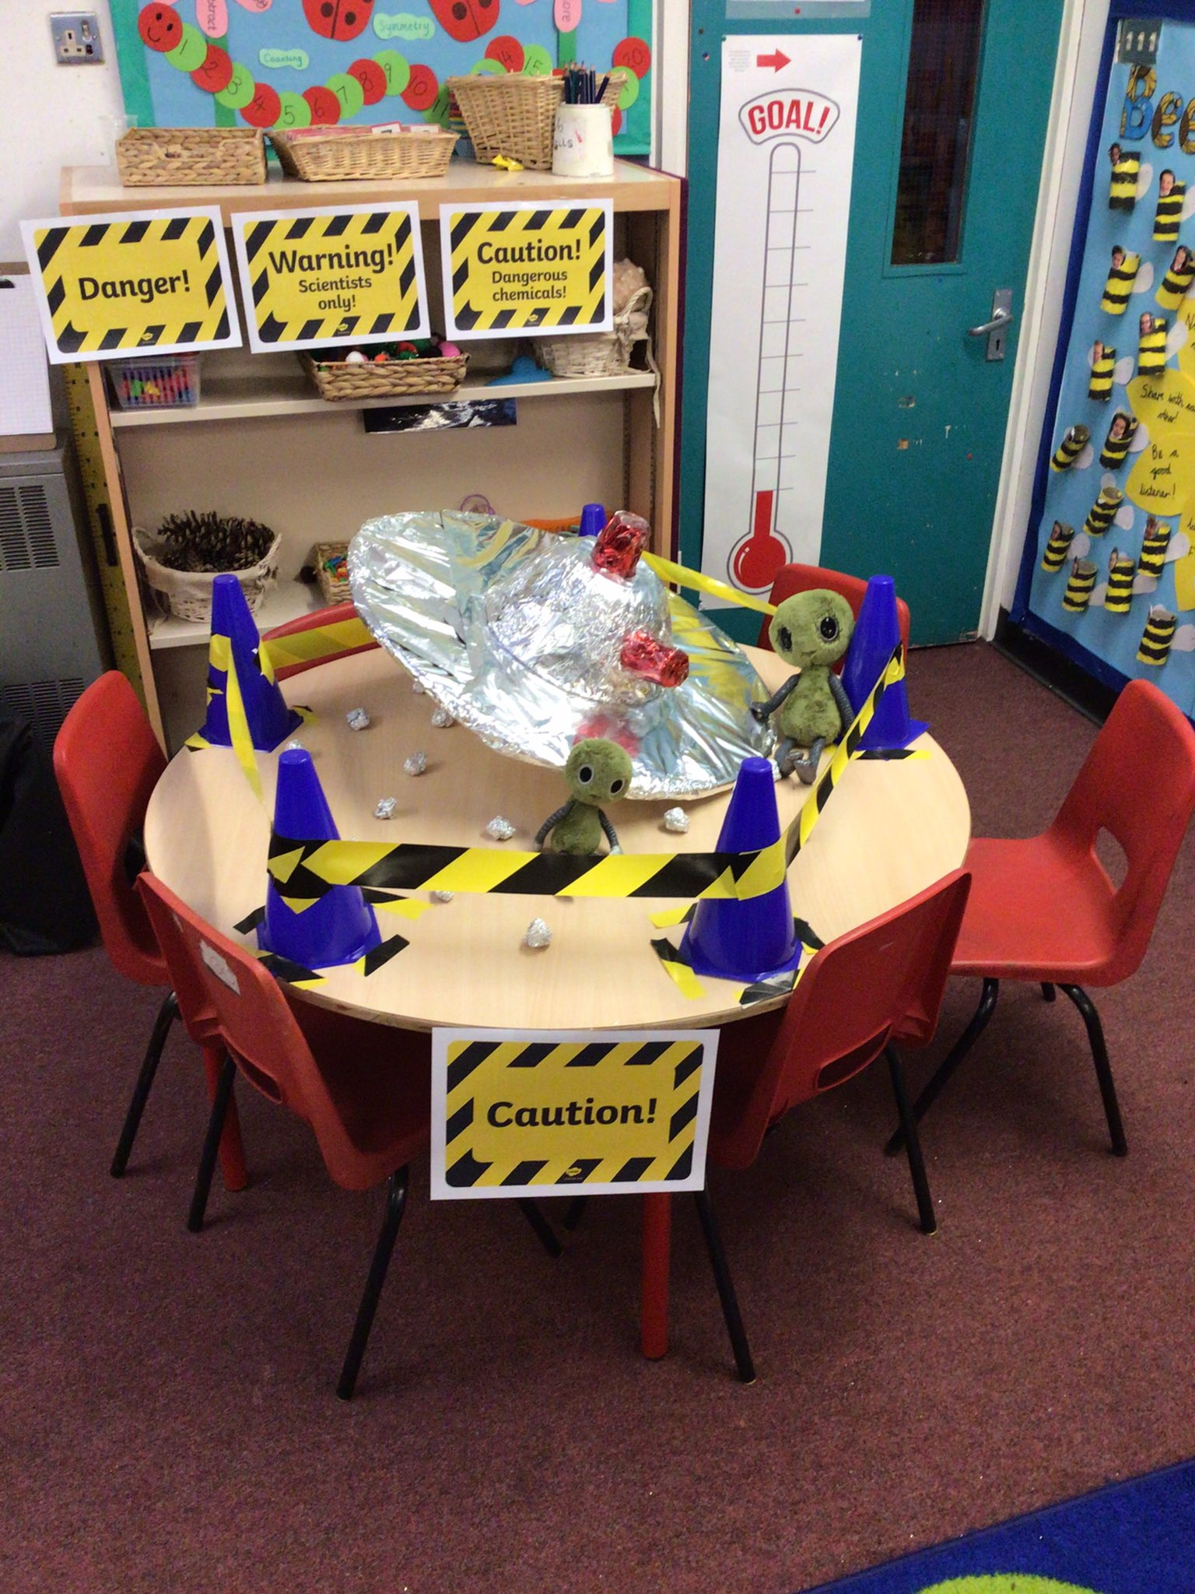
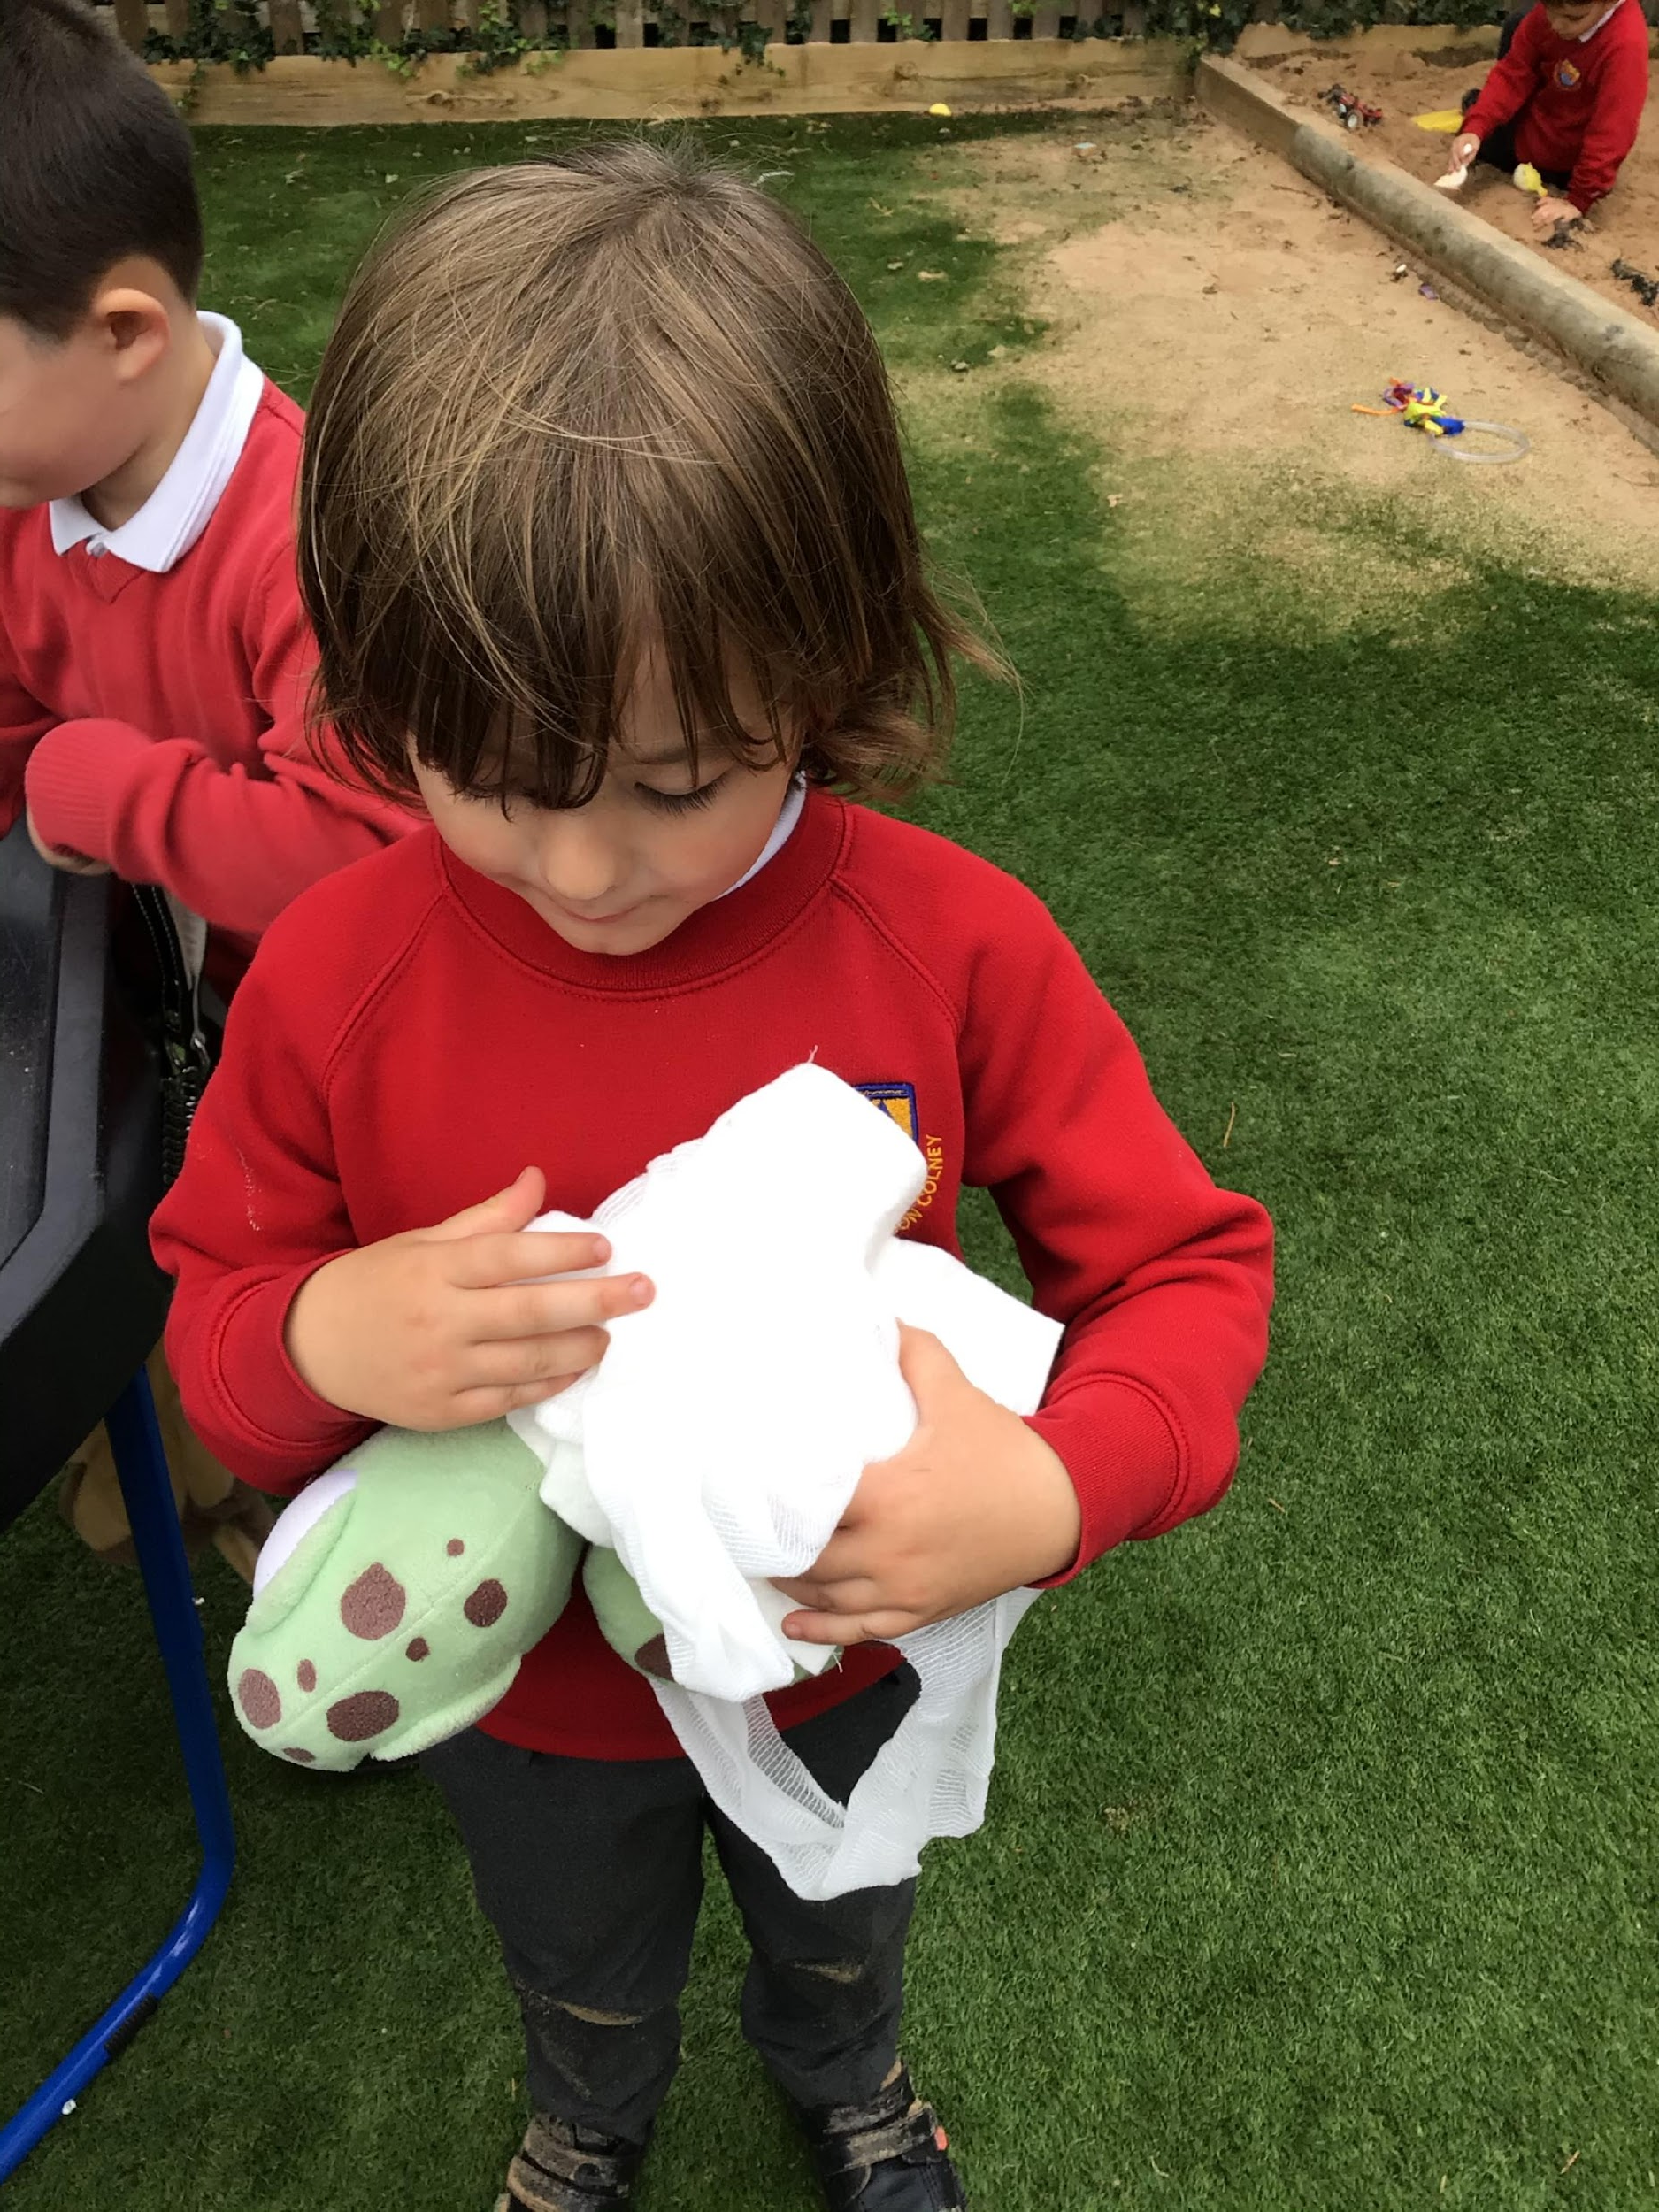
St Bernadette Catholic Primary School
“Learning to grow in knowledge, faith and love through friendship with Jesus and Mary.”
EYFS Curriculum
Each day, different activities are set up in our indoor and outdoor areas for CIL. This is time where the children can initiate their own learning and choose what areas they would like to be in. At this time, the children can flow freely from inside and outside.
Save the Turtles!
Parachute Fun!
Church Role Play
Alien Crash Landing!

Slide 7
St Bernadette Catholic Primary School
“Learning to grow in knowledge, faith and love through friendship with Jesus and Mary.”
Parent/School Partnership
Before your child starts Nursery, we visit you and your child at home. Home Visits are a really valuable way of ensuring you are able to share information about your child. It is also an opportunity for us to share practical arrangements ready for your child starting Nursery.
There is a signing up sheet floating around this afternoon for you to sign yourself up to a slot for us the Class Teacher and Teaching Assistant to visit you and your child at home.
Notes:
Before your child starts at our Nursery- we want to ensure that the transition to us is a smooth as possible
In order for this to happen, we invite you as parents to meet with our staff in order to share some information about your child so that we have some prior information on them before they start
Usually this would look like a home visit, but as the Pandemic has made this rather difficult and unrealistic, we have instead opted to inviting you and your child to our school.
Here they can meet their teacher, explore the classroom and the outdoor area!

Slide 8
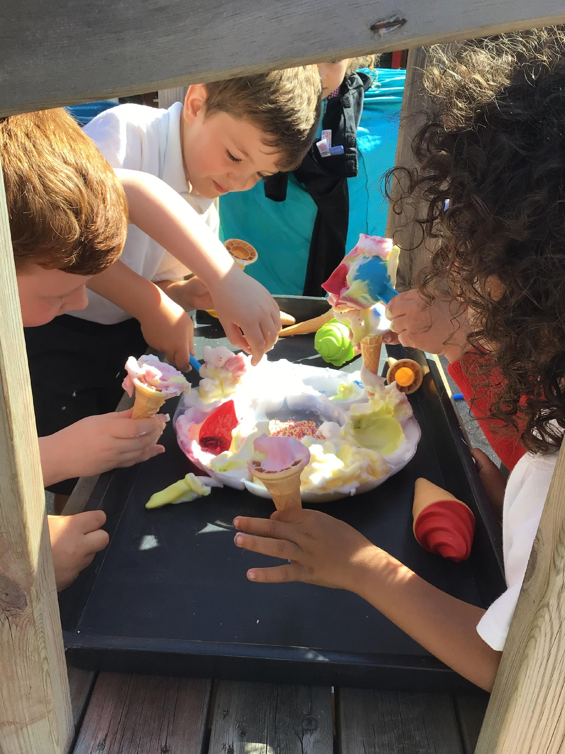
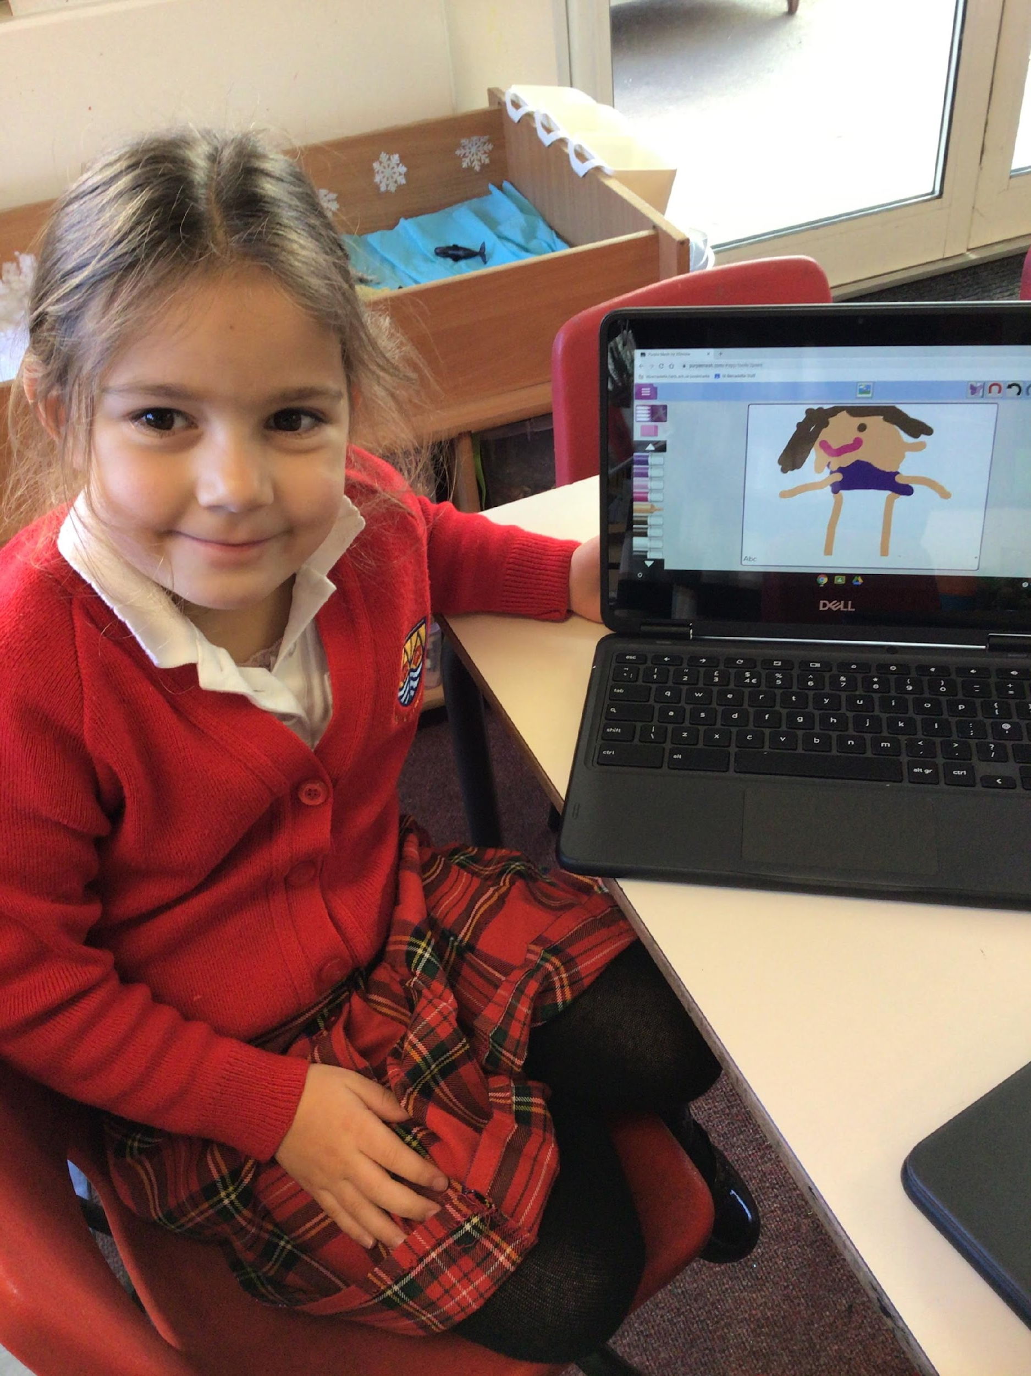
St Bernadette Catholic Primary School
“Learning to grow in knowledge, faith and love through friendship with Jesus and Mary.”
Tapestry
We use an online learning journal called Tapestry. This is where we gather photos and observations – recording your child’s progress in their learning. We use this platform to share ‘WOW’ moments with you and to share important information. We then file the observations and other completed work into a file. This is a working document and it is available to you, your child and any nominated people to look at, at anytime and contribute to. As this is an online profile we will need your permission to set up your child’s account.
Technology
Ice Cream Parlour
Notes:
One of the things we do to ensure good communication between EYFS staff and you as parents, is our use of Tapestry
Tapestry is an online learning platform, where staff can upload videos/images of your child which can be shared with you at home
We upload WOW moments of your child throughout the week which you at home can like and comment on- it essentially gives you an inside picture of what happened on that day!
Additionally messages can be uploaded by staff or family for each other to see
Another great use of it is sharing photos for show and tell- parents often upload posts to update us on their holiday whereabouts, which we can share with the other children in the class

Slide 9
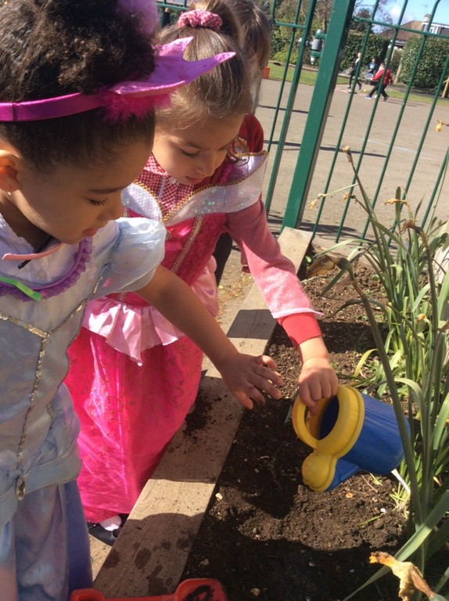
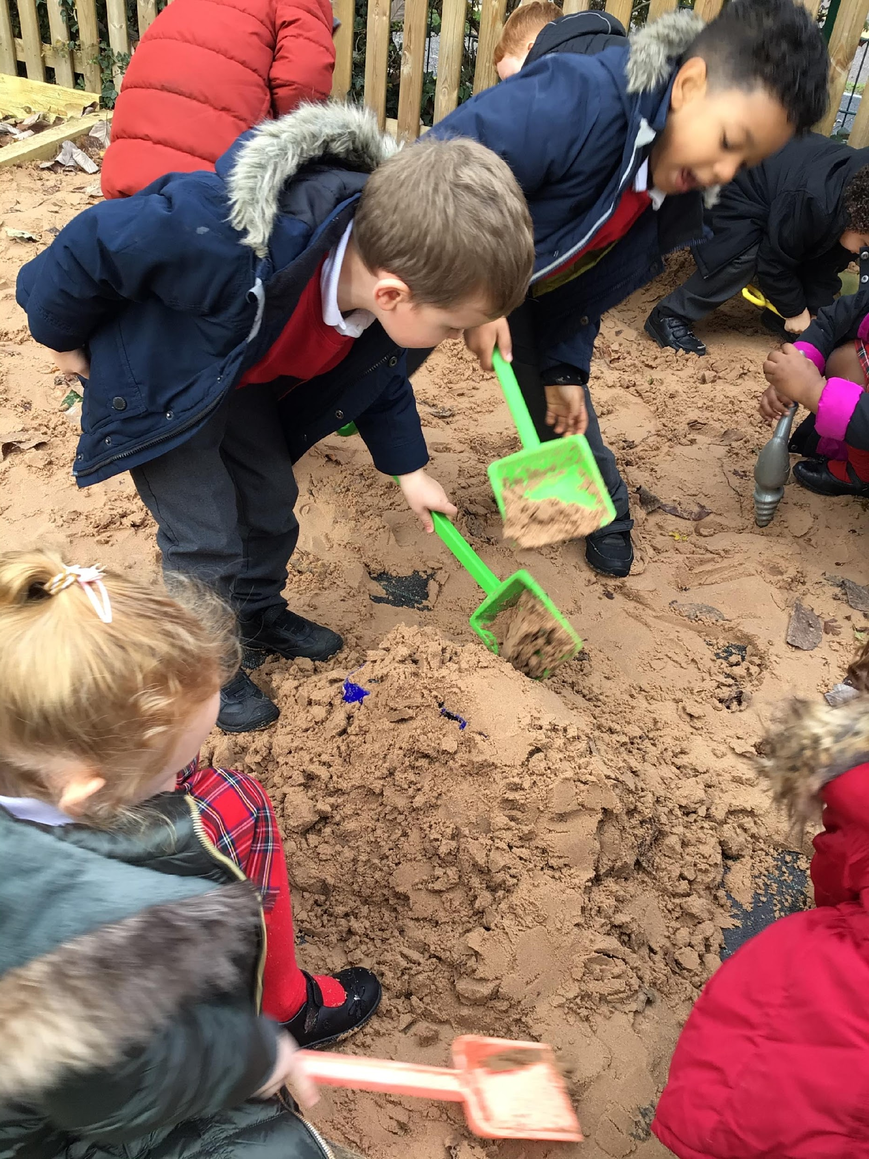
St Bernadette Catholic Primary School
“Learning to grow in knowledge, faith and love through friendship with Jesus and Mary.”
Tapestry
In your packs today, there are some documents that we urgently need you to fill in prior to starting in September. This way, we can set up Tapestry ready to go before September.
If you could please fill them in if you have not already and return them to me before you leave today.
We also have a document in your pack called ‘Authorised Adults’. This is another urgent document, which states any other adults (not parents) that may collect your child.
Building Sandcastles
Caring for plants

Slide 10
St Bernadette Catholic Primary School
“Learning to grow in knowledge, faith and love through friendship with Jesus and Mary.”
The Village Pre School
The Village Pre-School is run from the old Nursery on our premises. They take children from the age of 2 upwards.
They will collect children in our current nursery for afternoon provision for those families wanting to use the 30 hrs childcare provision.
Notes:
On our school grounds, also stands our old Nursery building
This has been transformed over the last summer into a Pre-School
It is run by a qualified Teacher
If you require afternoon provision, then this could be the approach for you
The Pre School Staff come to the Nursery door and escort the children through the KS1 playground over to the Pre-School (the children will not have to leave the school premises in order to do this).
I will show you this later on

Slide 11
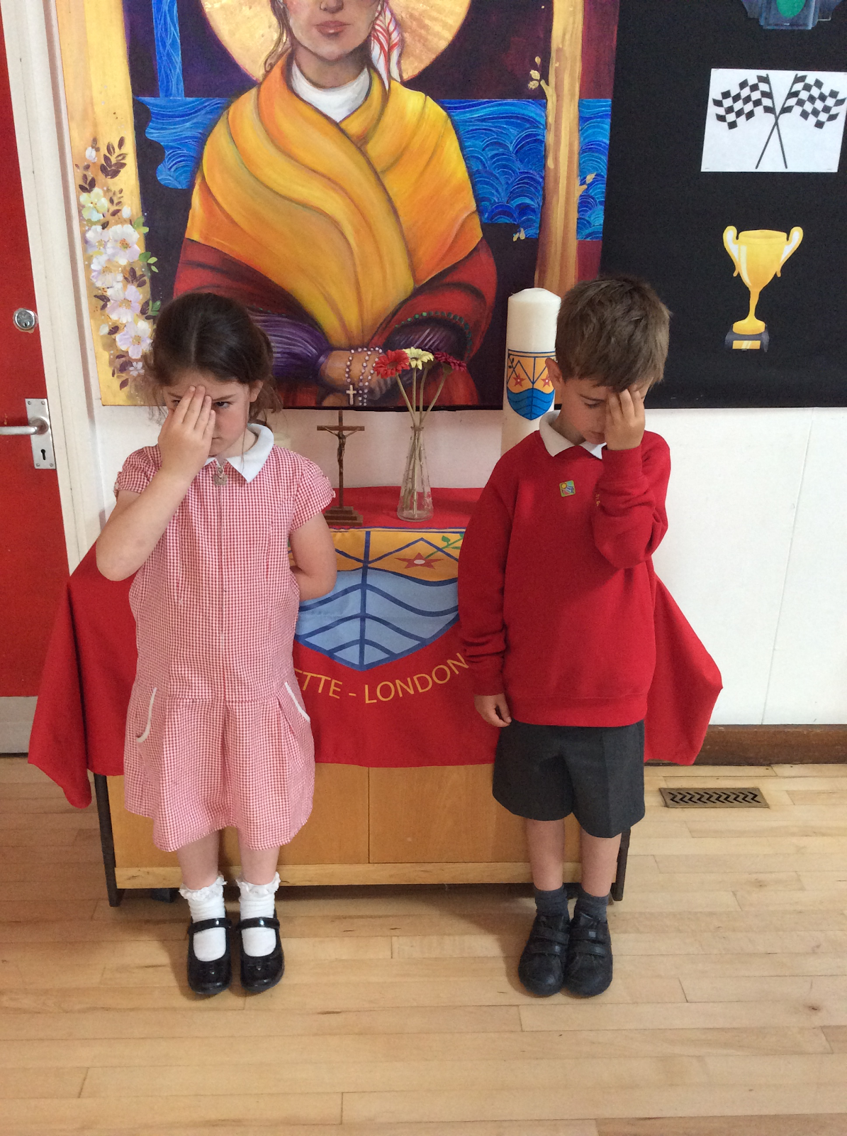
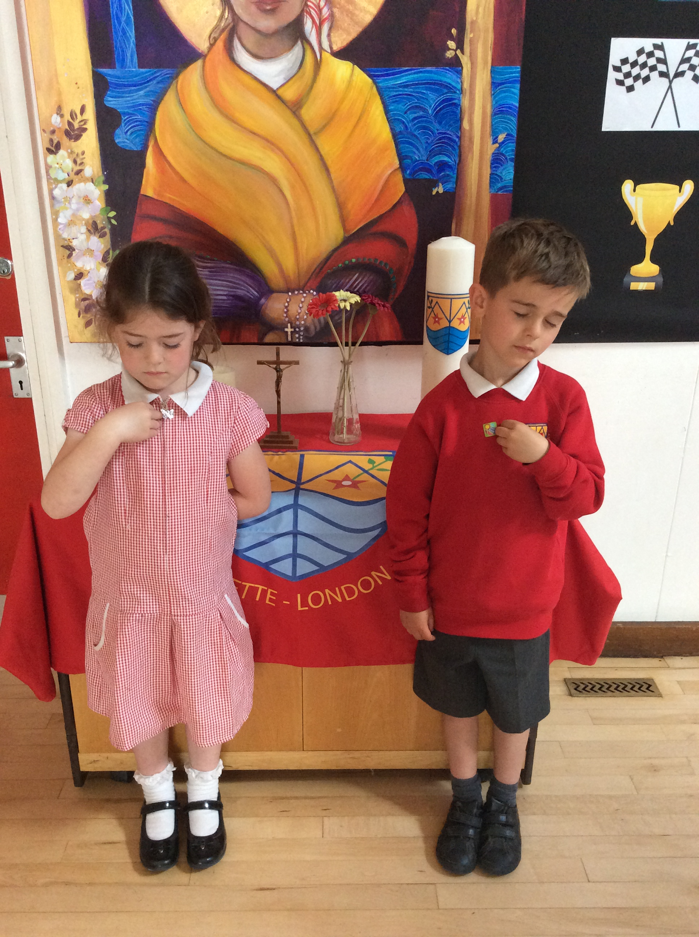
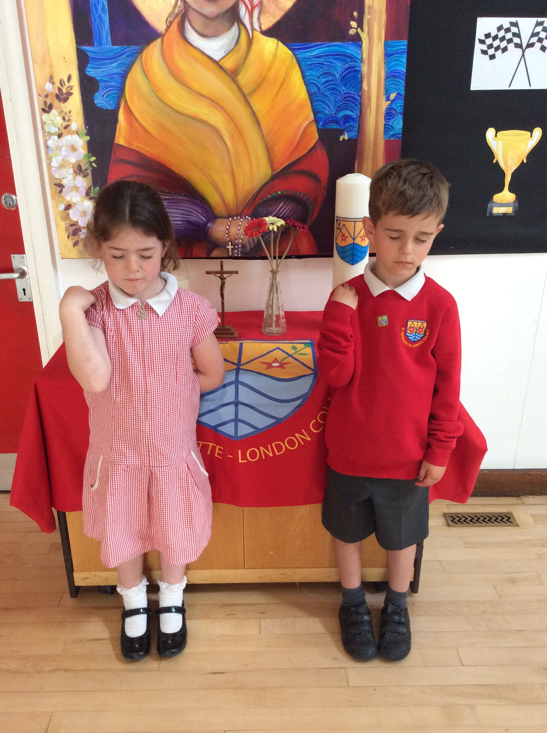
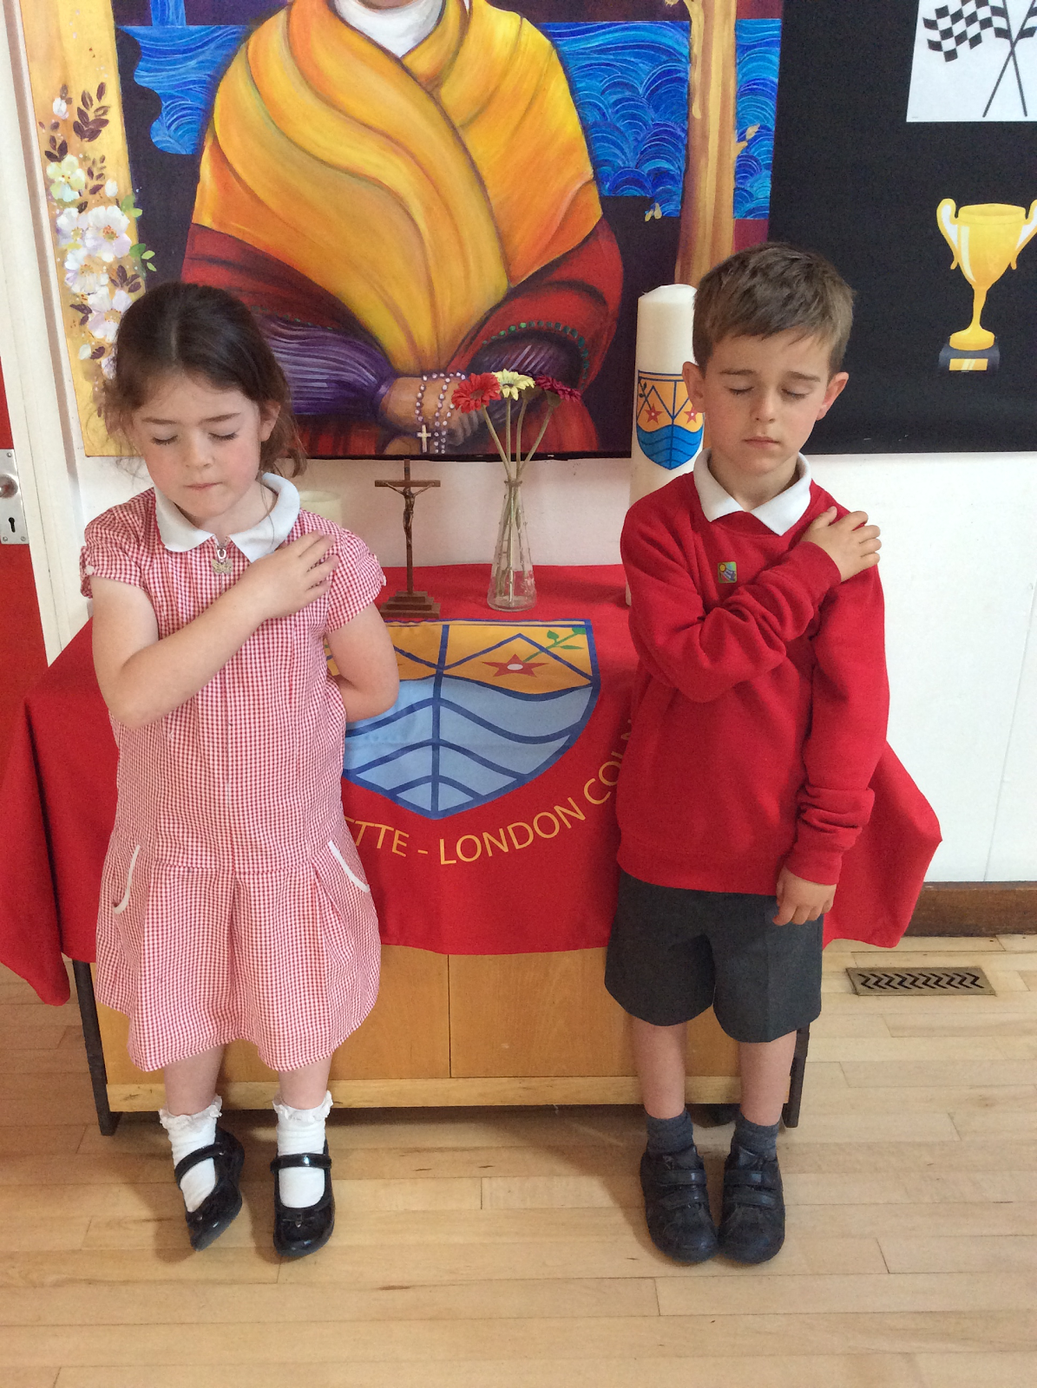
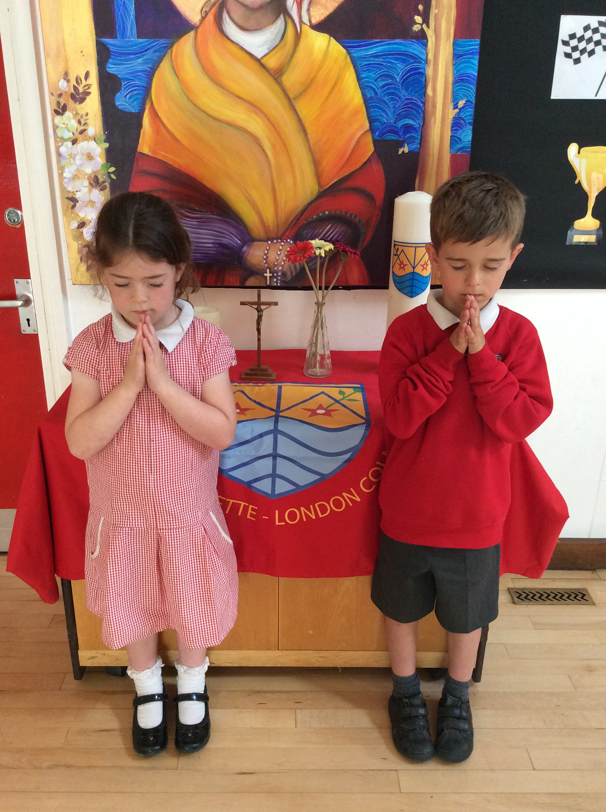
St Bernadette Catholic Primary School
“Learning to grow in knowledge, faith and love through friendship with Jesus and Mary.”
Morning Prayer
Oh my God, you love me,
You are with me night and day.
I want to love you always in all I do and say.
I’ll try to please you, Father, bless me through the day.
Amen.
Praying at School
Prayer is a very important part of our curriculum and in Nursery we teach one RE lesson each week. We also have a weekly reflection time, where the children get to join in with a group prayer session or learn about different stories from the Bible.
End of Day Prayer
God our Father
I have come to say
Thank you for your love today.
Thank you for my family and all the friends you give to me.
Guard me in the dark of night and in the morning send your light.
Amen.
In the name of the Father
And of the Son
And of the Holy
Spirit
Amen.
Notes:
As we are a Catholic School, prayer is a part of our day
The children in Nursery pray two times a day (upon arrival and upon dismissal) they also learn how to make the sign of the cross
The Children also take part in a RE lesson which could focus on our Catholic Faith but also different Faiths and different Cultures

Slide 12
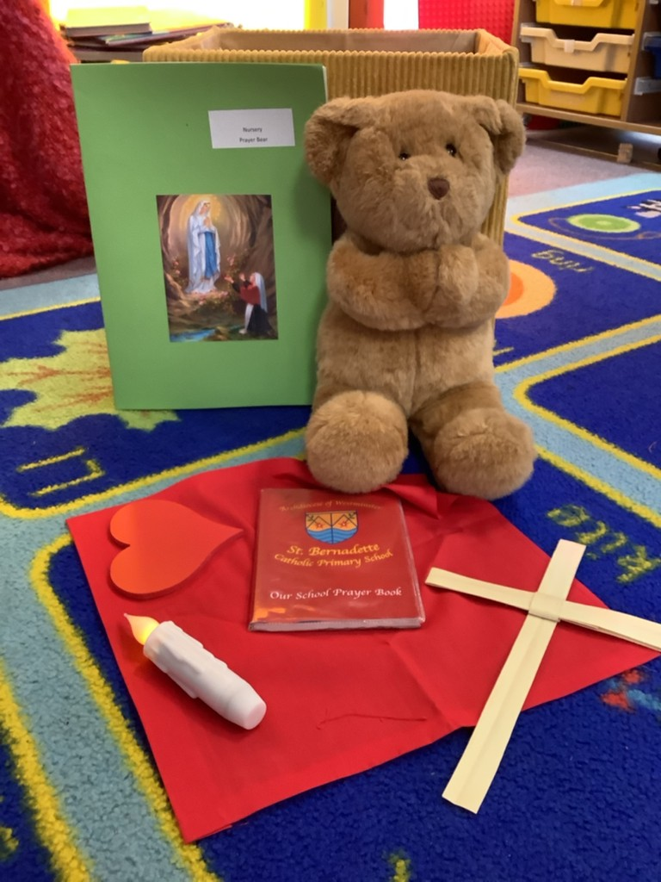
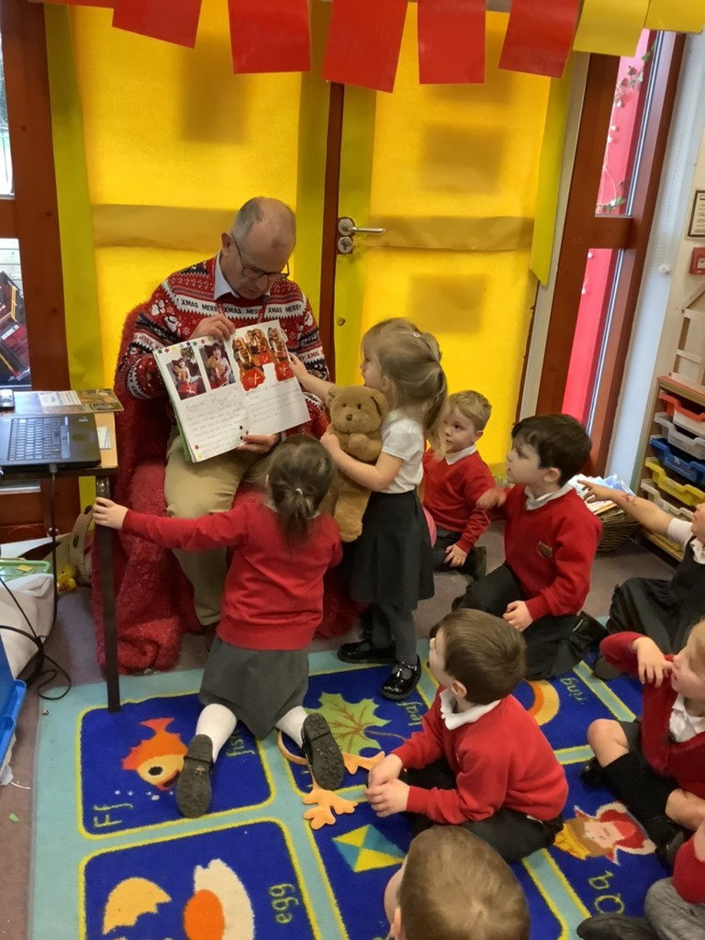
St Bernadette Catholic Primary School
“Learning to grow in knowledge, faith and love through friendship with Jesus and Mary.”
Prayer Bear
The lower classes in the school have each been allocated a ‘Prayer Bear’. Prayer Bear gets to go home with a different child every week.
Prayer Bear has its very own belongings, including a prayer book, where the children can draw pictures of people they want to pray for with the support of their family members. This is then shared with the class, before given to the next child.
Prayer Bear
Presenting Prayer Bear
Notes:
One of the latest things we have introduced is Prayer Bear, which works a little like the typical class bear

Slide 13
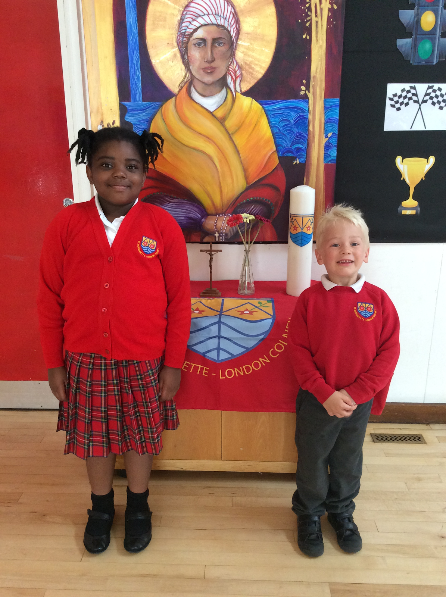
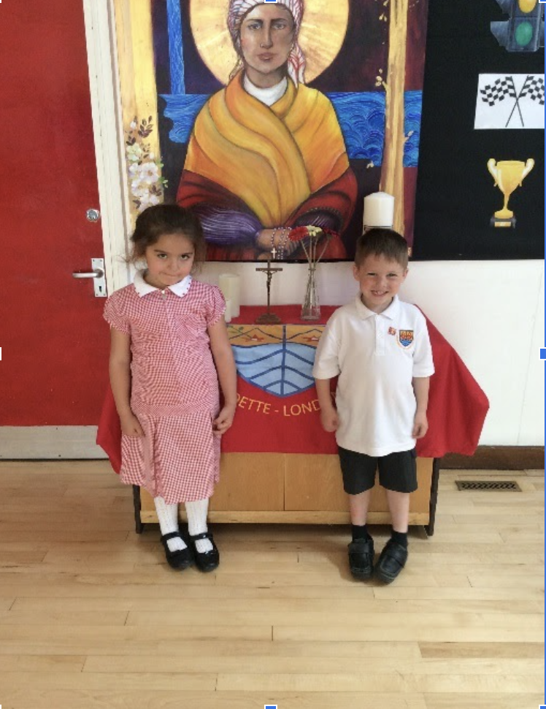
St Bernadette Catholic Primary School
“Learning to grow in knowledge, faith and love through friendship with Jesus and Mary.”
Uniform
Winter Uniform
Summer Uniform
Stockists
Stevensons (St Albans) is the supplier for all school uniform.
Winter/Summer Hats and book bags are available from the school office.
Other items are readily available in high street stores.
Footwear should be suitable low heeled school shoes. Open toes and sling backs are not allowed for safety reasons.
For health reasons, trainers are only allowed to be worn for PE and playtimes.
Grey shorts/trousers with socks
Red kilt/grey skirt with socks
Red jumper/cardigan
Red gingham dress for the Summer term and until October half-term
White Shirt
Black sensible shoes (not laced for Y1 below)

Slide 14
St Bernadette Catholic Primary School
“Learning to grow in knowledge, faith and love through friendship with Jesus and Mary.”
PE
On one day a week, the children will be asked to come into school in PE kit. This day will be confirmed once we begin the new academic year, by the class teacher.
Here is what the PE kit could look like. We encourage tracksuit bottoms or leggings in the winter and shorts in the summer.

Slide 15
St Bernadette Catholic Primary School
“Learning to grow in knowledge, faith and love through friendship with Jesus and Mary.”
Toilet Training
In Nursery, there is an expectation that the children are toilet trained. If you child is not yet at this stage, then please work on this over the summer.
We do not have the facilities in our classroom to manage this. The occasional, odd accident is understandable, but we do ask that children are confident to manage their own toileting needs themselves as much as possible.

Slide 16
St Bernadette Catholic Primary School
“Learning to grow in knowledge, faith and love through friendship with Jesus and Mary.”
Messy Play
A huge part of our Early Years Curriculum involves messy play. We do try our best to ensure that aprons or other appropriate protective clothing is worn during these times. There may be the occasional messy activity that is missed, resulting in untidy or dirty clothes!

Slide 17
St Bernadette Catholic Primary School
“Learning to grow in knowledge, faith and love through friendship with Jesus and Mary.”
First Week in September
Monday 5th | Tuesday 6th | Wednesday 7th | Thursday 8th | Friday 9th
Scheduled Home Visits | Scheduled Home Visits | All children in | All children in | All children in
Following Week: All children in each day

Slide 18
St Bernadette Catholic Primary School
“Learning to grow in knowledge, faith and love through friendship with Jesus and Mary.”
September ready checklist
Have you got…
A named water bottle that they recognise
An extra bag of spare clothes (in case of accidents or messiness)
A named school jumper/cardigan
Named school shoes
Have you completed and handed in…
Tapestry Permission form
Tapestry email information form
Authorised Adult form
Application documents

Slide 19
St Bernadette Catholic Primary School
“Learning to grow in knowledge, faith and love through friendship with Jesus and Mary.”
Any Questions?

