Slide 1
Teacher: Mrs Heatley
Learning Support Assistant: Mrs Guan

Slide 2
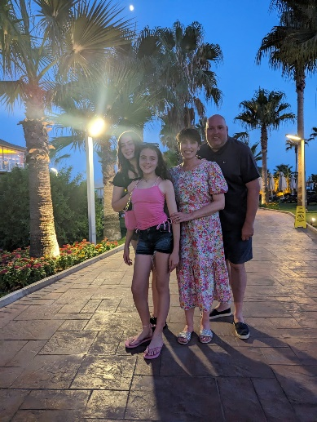
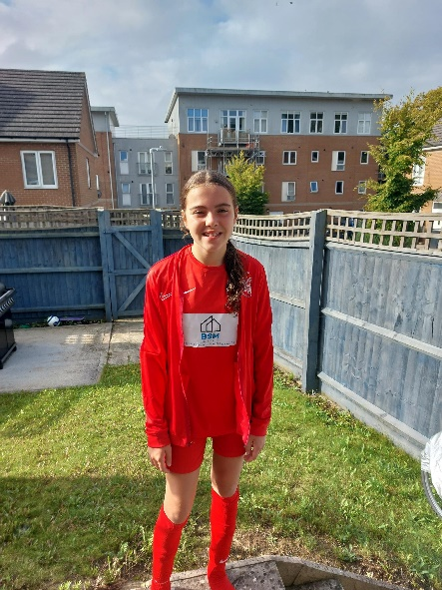
A bit about me!
As your child’s class teacher, we will be spending a lot of time together over the next year, so here is a little bit about me!
Jessica
I live in Borehamwood.
I have 2 daughters Sarah who is 18 and off to university
and Jessica who is 12 and in Year 8.
Sarah

Slide 3
Although I am new to St Bernadettes, I have been teaching
for 24 years!
I have worked in 2 different Catholic primary schools in the
London Borough of Haringey and was in my last school for 19
years! My daughters attended the school too.
I have worked in various year groups, from Reception to Year 3.
But the majority of my career has been in Early Years.

Slide 4
Staff working in Reception
PPA Cover – Ms Merrell
Every teacher is given PPA time each week (Planning, Preparation and Assessment time)
I will be out of class on Tuesday and Wednesday afternoon so Ms Merrell will be teaching
during these times and will dismiss the class at the end of the day.

Slide 6
Routines:
P.E lessons are on Wednesday mornings from 9am to 10am.
The children can come to school on a Wednesday in their P.E kit.
Later on in the year we will ask for their P.E kits to be brought into school but for the beginning
of the year the children come to school ready for P.E
The P.E kit consists of:
We have Music on a Thursday morning with a specialist teacher.

Slide 7
Book changing will be on Wednesday.
Your child will receive one scheme book and a book from our class library for you to read to them, every week on Wednesday.
The books we send home first have no words in them, please do not worry! Encourage your child to tell you the story using the pictures. Talk about what will happen next, what the characters are doing, where is the story set etc.
Please ensure your child has their reading diary, scheme book and library book in their book bag on that day.

Slide 11
All this information in available on the school website.

Slide 12
Assessment:
Government Baseline Assessment: September 2023
Ongoing observational assessments throughout the year on Tapestry.
EYFS Profile: June 2024 (GLD)

Slide 21
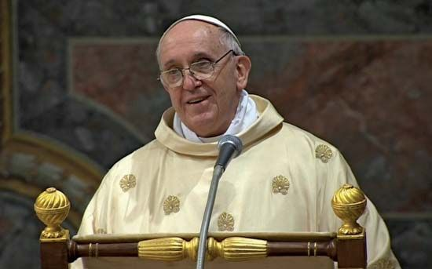
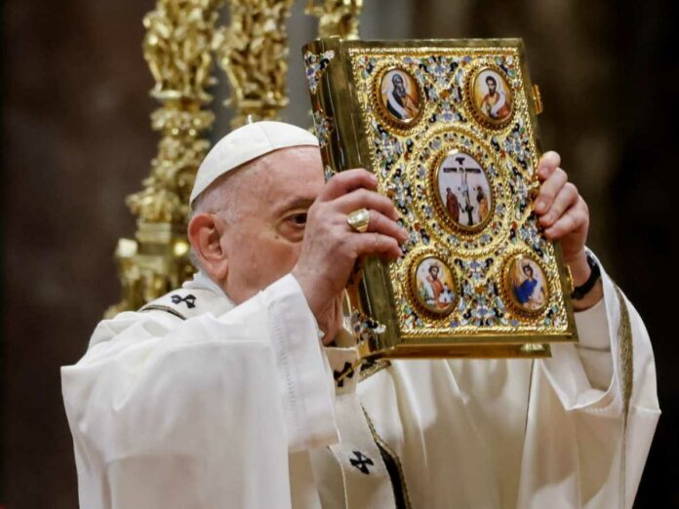
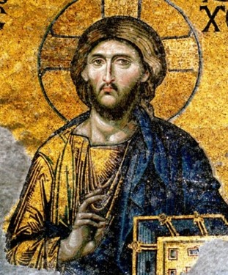
We also have a lesson on R.E each week.
We follow a scheme of work and the topics change every few weeks.

Slide 24
Other future dates this term:
There is a Reception Welcome Assembly Wednesday 27th September with our Year 6 buddies.
Parents Evening will be in November.

Slide 25
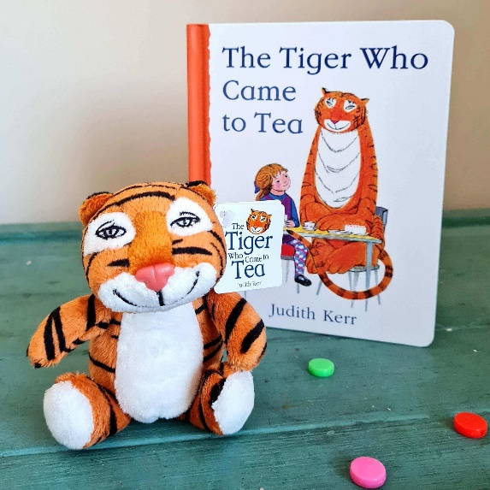
The Tiger who came to Tea.
Every Friday one child in the class will bring home a tiger so that they can have tea together for the weekend.
Please upload photos to Tapestry and your child can talk about their weekend with the tiger in school.

Slide 26
Reward chart.
Every morning children start on the rainbow then they can move their
name up onto sunny/cloudy and then if they move their name up to sunshine. When they have 10 sun shines they get a prize from my special box.

Slide 27
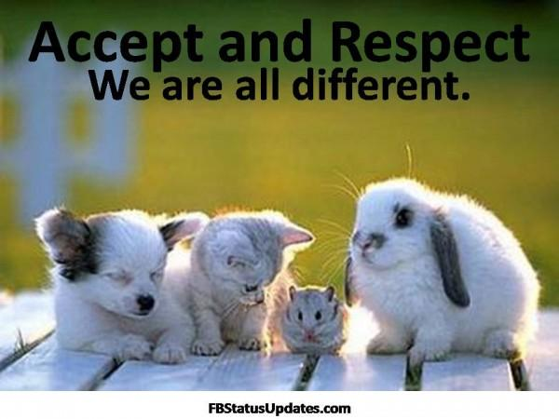
We do have a range of children with differing needs in our class. Obviously each child is unique and different
and some children find things harder than others, for example, sharing toys, sitting still on the carpet.
Please show respect and understanding and help us to celebrate the differences we all have.

