Slide 1
Year 4
mEET THE TEACHER
September 2024
Welcome to Year 4!

Slide 2
A bit about me
As your child’s class teacher this year, we will be spending a lot of time together. Here is some information about me for you to get to know me on a personal level:
I attended St Bernadette as a child and was taught by both Mrs Lavelle-Murphy and Mrs Reilly.
This is my second year of teaching.
I always had strong relationships with my teachers and this is something that I think is important to establish early when starting with a new class.
I completed a 3 year Bachelor of Education course at the University of Hertfordshire and gained my Qualified Teaching Status at the end of this.
I am very caring and want all of your children to succeed. I received a lot of positive feedback from the cohort of parents I had last year about how much I cared for the class and their wellbeing. This will remain a priority of mine this year with your children.

Slide 3
Staff in year 4
There are a number of adults who will be working in Year 4 this year:
Class Teacher - Mr Reeve
Teaching Assistant - Mr McDonald - PM
SEN Support - Miss Darker (AM) and Mrs Plant (PM)
PPA Cover - Ms Bell
Every teacher is given PPA time each week (planning, preparation and assessment time). My PPA is on a Tuesday morning, therefore Ms Bell will be teaching on a Tuesday morning until lunch.

Slide 4
What is new in year 4?
There is a not much that changes between year 3 and year 4. A lot of the curriculum that is taught in year 4 has been put in place to build upon the knowledge and understanding that the children would have acquired in year 3.
In year 4 I would expect more independence from the children. I like to install the mindset of being resilient and attempting things first before asking for support.
The children are likely to have grown over the summer and this year are working in a much smaller classroom compared to last year. It is important that they try and work well with each other to maximise all the learning time that we have available to us.
I appreciate that it can be daunting to have a male teacher when it is unlikely that they would have had one in the lower ends of the school. This is why I prioritise building relationships and getting to know the class in the first half term of the school year.

Slide 5
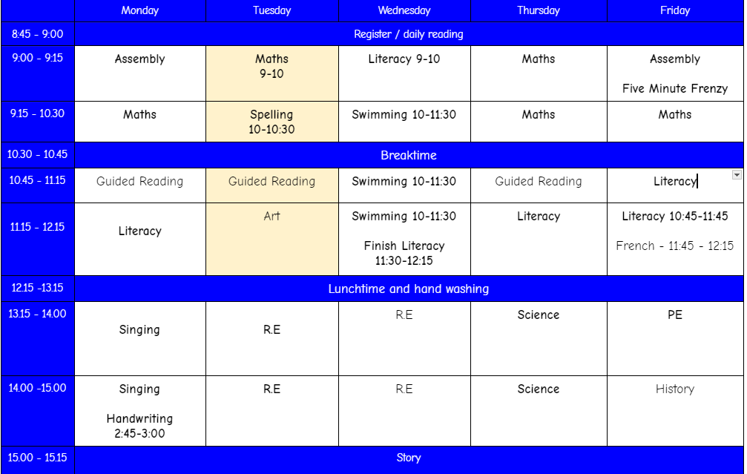
TIMETABLE IN YEAR 4

Slide 6
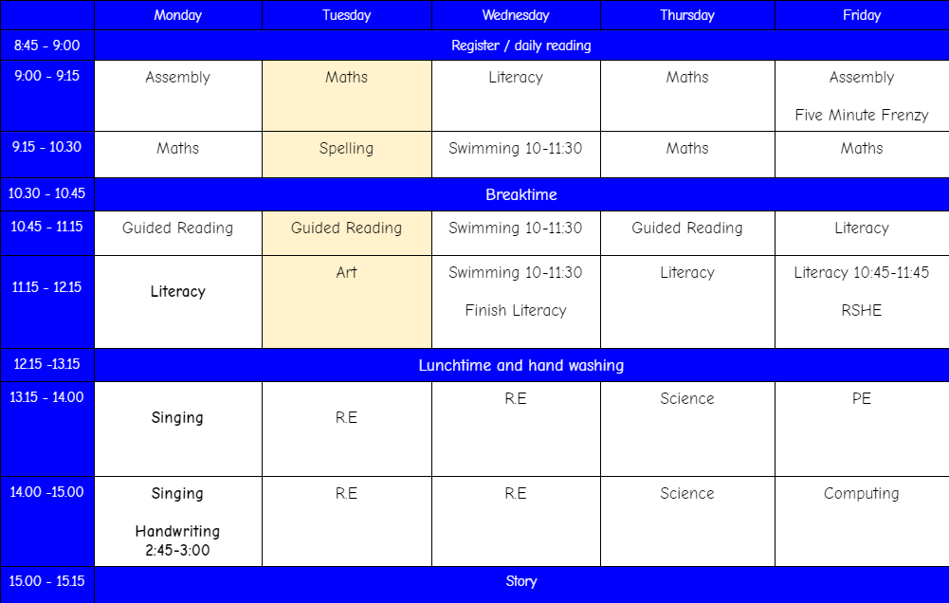
TIMETABLE IN YEAR 4

Slide 7
Maths in year 4
It is important by the end of the year 4 that your child is confident with the following:
Multiplication facts up to 12 x 12.
Working with numbers up to 10,000.
Dividing larger numbers for example dividing 3 digits by 1 digit.
Fractions - improper fractions, mixed number fractions and equivalent fractions.
Time - try and encourage telling the time using an analogue clock as much as possible outside of school.
Purple mash, top marks, TTRS and other platforms will provide excellent support with all of things mentioned above.

Slide 8
writing in year 4
There are certain aspects of your child's writing that they will need to be confident with by the end of year 4 to meet the expected standards of a year 4 child. These include:
Using speech correctly and ensuring this is correctly punctuated.
Developing the use of vocabulary in all written work. I will be encouraging the use of a thesaurus and chromebooks in writing lessons to support this.
Using conjunctions, adverbs, prepositions and pronouns in writing.
Using past and present tense correctly.
Consistent use of punctuation taught prior to year 4.
Accurate spelling of the year 3 and 4 statutory words. (I will upload these on to google classroom)
Neat handwriting - I have already noticed some excellent handwriting in this class and look forward to awarding pen licenses this year.

Slide 9
Reading in year 4
When you are reading with your child at home, please ensure you are signing their reading record and this is coming into school daily. As part of the weekly homework, I will be checking reading records every wednesday. We will change reading books for those who require one on a wednesday as well.
It is important that your child has a secure understanding of the text they are reading. You can assess this through the use of the following questions:
How did....?
Why did....?
What words tell us...?
How do you know...?
How has the author created the feeling of...?
Please make a note of any new vocabulary that your child has encountered in their reading record when you are commenting.

Slide 10
MTC - Multiplication tables check
At the end of year 4, every child will sit an official times tables test. This is an online test where the children will have to answer 25 multiplication questions and will have 6 seconds to answer each question. The 25 questions will be randomly generated.
Throughout the year will be working hard to ensure that the class are ready to take this test. We have started doing 10 random questions every morning before we begin any lessons. We will continue with five minute frenzy in year 4 and we will do this every Friday.
At home please encourage your children to spend time on TTRS. I have three trophies which I will start to award weekly. This will be given to the children based on effort, progress and accuracy.
I will also upload links on to google classroom where your child can practice their times tables using the same format as an MTC.

Slide 11
2023/2024 MTC Results
Through the strategies that were previously mentioned we achieved some excellent scores in the test last year:
The average score across the class last year was: 23
53% of the class achieved 25/25
We would like the children to be scoring 21 and above on this test. Last year 87% of the class achieved this score or above.

Slide 12
My classroom
The class have responded very well to the class rules and my expectations already this year. I like to instill a team mentality into the classroom. I encourage that they work well together as a whole class. This first half term is perfect to install any routines and expectations into class that will make it clear what is expected of the children.
I have adopted a therapeutic approach to behaviour in the classroom over the last year. I will always look to praise where possible. I might do this through the use of extra break time, prizes, marbles (when they earn enough they earn a party).
I will also praise the children using the reward systems we have within in the school through the use of house points, merits and Roll of Honour.
In line with the behaviour policy, persistent negative behaviour will lead to time out of class with Mrs Bennett.

Slide 13
Interventions and support
All adults in the class are here to provide support during lessons. During core subjects, I will aim to work with targeted small groups who feel as though they require extra support.
Alongside this I will be using follow ups - a small activity for the children to complete if they have not met the objective of the lesson.
Reading - Mr McDonald will be reading with children daily with the aim to develop fluency and comprehension skills.
Handwriting - Mr McDonald will be beginning to work with small groups in the afternoons for handwriting focusing on letter formation and cursive writing.
Number stacks - Mrs Smith will be taking over from Mr McDonald with this. She will work with a small group of children to focus on place value, number, addition and subtraction and multiplication and division.

Slide 14
PE Days
If you have not done so already, please can you ensure that your child has a PE kit in school that they can get changed into.
Wednesday mornings - swimming at Furzefield leisure centre.
Friday afternoons - PE at school.
After half term, Watford FC will be coming to work with year 4. They will spend half the afternoon focusing on healthy lifestyle options and the other half of the afternoon will be a physical activity. This will take place on a Thursday afternoon and there will be no PE on Fridays.
PE kits will be sent home at the end of every half term.

Slide 15
Google classroom - Homework
All homework will be uploaded on Google Classroom every Friday. Upon review from the parent survey in the summer term last year, the amount of homework that will be set has been changed. This year every friday the class will receive homework as followed:
Reading 3 times a week
TTRS at least once weekly
Watch the pre-learning video that will be uploaded at the beginning of each topic. (If the unit is a 3 week unit, this video will be a method that we will use for all 3 weeks and a new video will be uploaded when we begin a new topic).
Spelling Shed once weekly.
Half term projects - we will no longer be continuing with the 3 half termly projects. Every half term there will be a writing task set for homework which we would like the children to complete. This homework will then be stuck into books so please ensuring it is completed to a good standard.

Slide 16
logins
I will provide you all with a list of your child’s logins for any platform that has been mentioned. This will include logins for:
Google classroom (including the class code)
Purple mash
TTRS
Spelling Shed

Slide 17
TRIPS
This year in year 4 the school trips will be as followed:
Autumn Term - Hudnall Park
Spring Term - Natural History Museum
Summer Term - Hindu Temple

Slide 18
Hudnall park
The trip to Hudnall Park is an amazing bonding experience for the class. They will spend the 2 days that we are there participating in a variety of team building activities. The main activities that we are taking part in this year are:
Zip Wires
Low rope course
An art activity of some sort - more information will be given at the hudnall park meeting.

Slide 19
Hudnall park
All activities are on site where we are staying and will be run by members of staff who work there.
All the girls will share a room and all the boys will share a separate room.

Slide 20
Contact
If you have any concerns that you wish to discuss throughout the year please contact the school office on:
parents@stbernadette.herts.sch.uk
They will forward your email to my inbox where we can arrange either a telephone conversation or a face to face meeting.
If there are smaller concerns that can be resolved quickly, please feel free to talk to me at the door either in the morning or at the end of the day.

Slide 21
Thank you all for coming this afternoon.
I am really looking forward to working together this year.

