Slide 1
Year 6
Meet the Teacher
2024

Slide 2

Class Teacher: Mrs Bennett
Cover Teacher: Miss Bell
Teaching Assistant: Mr McDonald

Slide 3
What’s new about Year 6?
Buddies
Year 6 are matched with a Reception buddy to support them in their first year at St Bernadette. Being a great buddy to a new child is a big responsibility but one that Year 6 love! It’s great to see their relationships grow throughout the year!
Role Models
As the oldest pupils in the school, Year 6 are now the role models for all of children in the school.
Roles and Responsibilities
Year 6 roles will be voted for by the rest of the school and all the class will be given an important role to undertake this year. These include Hospitality Ambassadors, Chair, House Captains and Health Ambassadors.
SATs
KS2 assessment tests take place in May. These are nothing for the children to be worried about, our job is to prepare them fully so they feel confident to show their best. More detailed information regarding SATs will be shared in the Spring Term.

Slide 4

Topics
Autumn Term
Spring Term
Summer Term
Natural Resources
World War II
Ancient Egypt
Australia
Coasts
Ancient Benin

Slide 5
Reading
Each child has been given a reading book to take home which should be brought into school and taken home every day. They will also get a library book to read for pleasure, which can be changed on Fridays.
Children in Y6 are expected to record their reading in their reading record at least 3x a week. This will be checked every Wednesday. They can complete this themselves.
Whole class guided reading sessions focus on comprehension skills of retrieval, inference, summarising and predicting. Vocabulary is also a key aspect of these lessons.

Slide 6

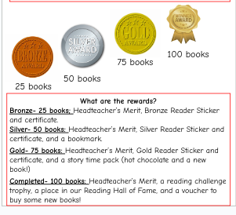
100 Books to Read Before You Leave St B.

Slide 7
End of Year Expectations
Please see the document on Google Classroom for the end of Year 6 expectations for reading, writing and maths.

Slide 8



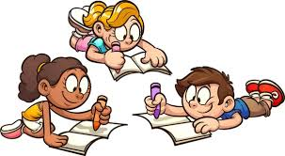
KS2 Homework
READ
*Children will be expected to read at least 3x a week and record it in their reading record. These will be checked every Wednesday.
ROCK
*Times Table Rockstars at least 1 x a week
*Watch the pre-learning videos added to Google Classroom at the start of a new topic.
WRITE
*Spelling Shed at least 1 x a week
*Writing task every half term (children can choose ONE from the options given on Google Classroom). Children will be given A4 paper to write on which will be stuck into their Literacy/Topic book once returned to school. Handwriting and presentation expectations are the same as the work the children do in school.

Slide 9
Behaviour and St Bernadette Values
Class Rules
Gold Cards
Marble Jar
Roll of Honour
Merits
House Points
Linked to school values and roles and responsibilities of Y6
Awarded for exceptional work, attitude or behaviour
Whole class reward system to work towards a class treat
Linked to St Bernadette 5 Bs
To reward outstanding effort, attitude or achievement
Individual praise and rewards for a particular piece of work

Slide 10
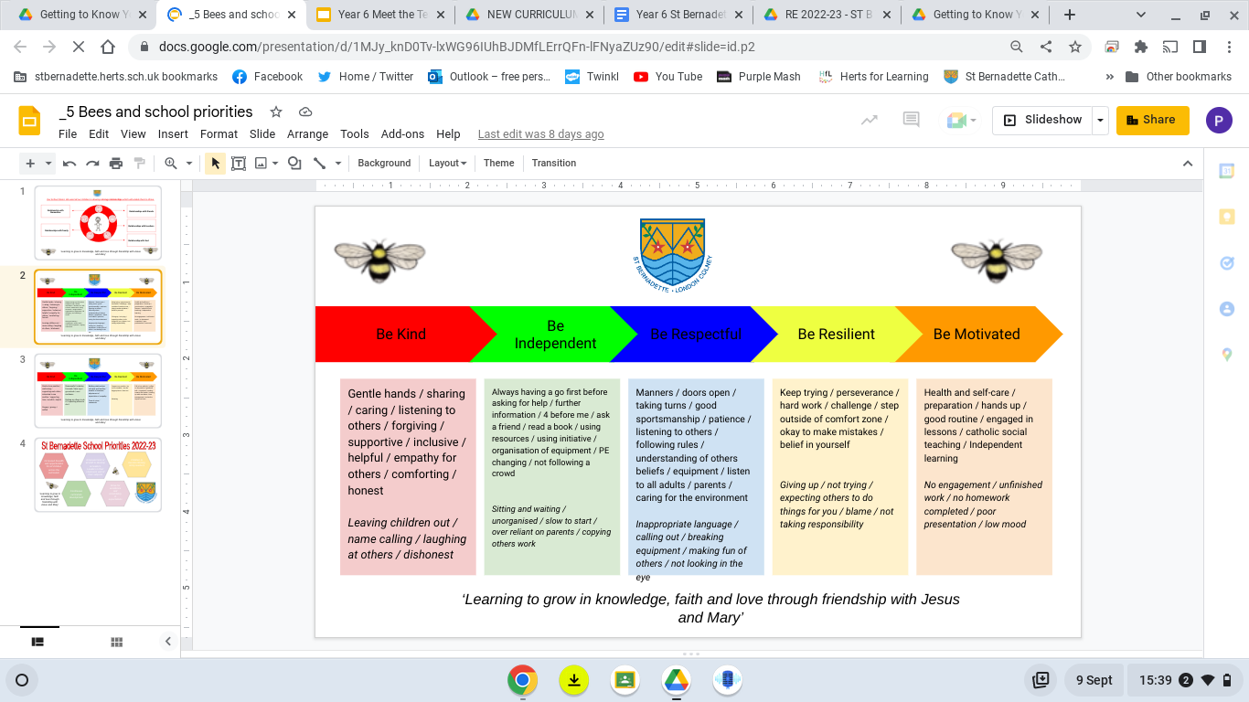
These are the values that we look for across all areas of the curriculum.

Slide 11
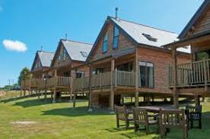

Isle of Wight
19th - 23rd
May 2025
*likely to be around £480 which can be paid in instalments.
Calbourne Water Mill,
Newport

Slide 12
Supporting your child
Reading
Please encourage your child to read regularly and record it in their reading record. Reading and building stamina really is the key for success and supports all areas of the curriculum.
Homework
Please encourage your child to complete their homework on time and to a good standard. This is an important step towards the homework expectations in secondary school.
Organisation, Independence and Resilience
This year really is about preparing your child for secondary school. Therefore, please encourage them to be well organised (for example with PE kits, pencil cases, etc) and to take more responsibility for themselves.

Slide 13
SATS week
Isle of Wight week
May.
12
Wed 25th Sept - Reception (Buddy) Welcome Assembly 9:15 am
Mon 30th Sept - New School Year Mass 10 am (at school)
DATE TBC - Crucial Crew @ St Albans Fire Station
Tues 8th October - Y6 Height and Weight
Mon 21st Oct - Harvest Festival for parents 1:30 pm
Tues 22nd Oct - Y6 Parent consultations 4:00 - 6:30 pm
Wed 23rd Oct = Y6 Parent Consultations 1:30 - 4:30 pm
Monday 12th May - Thursday 15th May
Key Dates for Y6 this term
Monday 19th May - Friday 23rd May

Slide 14
Going Home
Please confirm (by e-mail or in writing with the office) if your child is allowed to leave the classroom without an adult at the end of the day. This consent means that your child will be allowed out on their own every day unless they are told to wait for an adult on a certain day.

