Slide 1

Welcome to Year 5

Slide 2
A bit about me!
As you can probably tell from my accent, I’m not from the local area. I’m from Southport, near Liverpool.
I support Liverpool but my husband is a Spurs supporter - so I’ll allow these football kits but that’s it!!
I have 2 children, Tess and Flynn.
Tess is 5 and Flynn is 2.
So like you I spent my summer holiday
going around zoos, farms, parks!

Slide 3
I have been teaching for 10 years and have spent most of that teaching either year 5 or year 6. So I’m pretty familiar with the UKS2 curriculum.
My last school was in Marylebone in London, I left there because we moved to St Albans . This is my 4th year teaching at St Bernadette.
However i’m still navigating being both parent and teacher.
Tess has started year 1 and Flynn is in nursery, so I now understand how parents feel.

Slide 4
Teaching staff in Year 5
Class teacher - Mrs Wright
Class TA - Mrs Choppin.
Mrs Choppin will be in our class on every morning Monday to Friday.
PPA cover - Miss Bell.
PPA is on a Wednesday afternoon, so Miss Bell will be dismissing the children every Wednesday.

Slide 5
Life in Year 5
Life in Year 5 is not too dissimilar to Year 4, so the transition for the children should be pretty smooth. I taught them in Year 2, so we already know each other.
The main thing to consider is that we will start preparing the children for the SATs in Year 6.
Maths may become a little more challenging for them, as we introduce new concepts like percentages and fractions but there is nothing to worry about.
My hope is that by the end of the year, all the children in the class will be ready for their final year and will go into year 6 confident and happy.

Slide 6
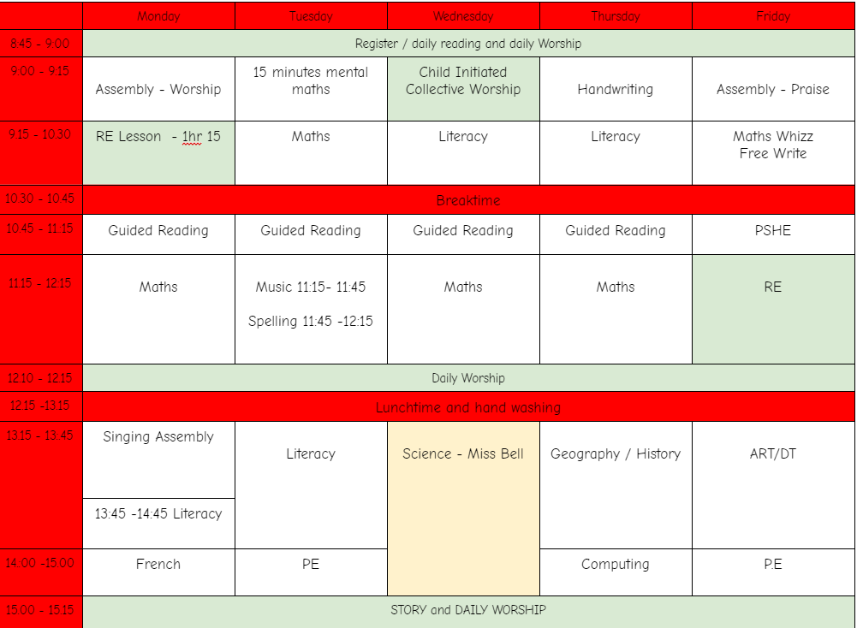

Slide 7
My Expectations
Children try their best in everything they do
They follow the class rules
They are kind to each other
They complete homework
They are prepared (PE kits etc)
They enjoy Year 5!
Quick note on stationary:
Children are asked to bring in their own stationary (handwriting pen, pencil, rubber, ruler, glue) and they will be keeping them in their desks.
As far as I am concerned, their stationary is for work NOT for playing with at their desks!
Library: We will visit the school library once a week. If your child has finished their book, they can swap it but they will need to return it before they can take out another book.

Slide 8
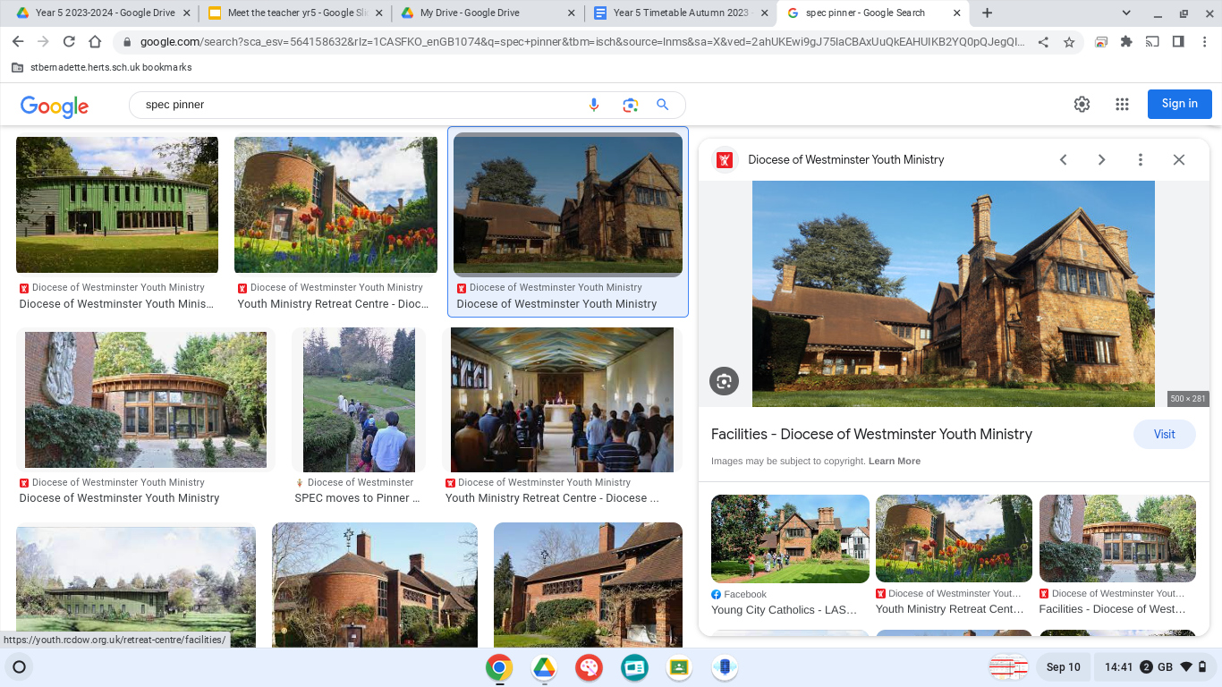
Trips:
We will try and go on a trip each term.
Our first trip will be to the Stem Discovery Centre (£23 estimated) - January.
In the Spring term we will be completing a local walk to the
River Colne - free
SPEC Residential: June (£165 estimated)
SPEC stands for Spiritual and personal Encounter with Christ. The residential retreats are a 2-night experience offering younger people an opportunity to get to know God, themselves and each other in a deeper way.
The SPEC retreat centre is located in Pinner, Harrow, North West London.
We will have a meeting about this trip nearer the time.

Slide 9
Communication
I will use Google classroom to set homework, showcase children’s work and for general reminders e.g. class parties etc.
It is not a form of communication for parents to message staff on.
If you do need to speak to me you can email the office and they will let me know.
Please be mindful that the end of day can be very busy and there are lots of children and parents around, so if you need to discuss anything important then the end of the day at the classroom door is probably not the best time or place.
I am happy to arrange a meeting before or after school or a phone call during lunch break.

Slide 10
Year 5, seems to be the year that some children discover social media.
Please remember that the age restriction for Facebook, Instagram, TikTok, Snapchat is 13 and WhatsApp is 16.
From my experience of teaching UKS2, social media seems to be one of the main causes of problems between the children, so I would ask you to monitor what your children are looking at and what messages are being sent .
Social Media

Slide 11
Homework
First of all, I must stress that homework is intended to HELP, not cause stress! I appreciate that life gets chaotic at times, you’re all very busy, and some children may not be so willing to work by the time they get home from a long day of school! I would however,really encourage the children to complete homework, as it takes the form of pre-teaching and aims to best prepare them for the week ahead. As the children are in Year 5 now, I expect them to take responsibility for their own homework but if you could just check it has been completed or give them a gentle reminder, I would really appreciate it.
Across all year groups, homework is not formally marked, however I will keep track of who has completed their homework and will be looking at how the children are managing.
Homework is set on a Friday, and is due in by Wednesday - obviously if there is a reason why your child cannot complete their homework, please let me know. As a teacher, you can really see the difference in the children’s work if they have completed the pre-teach homework.
Homework should be uploaded onto Google Classroom. If you any ‘technical’ problems with Google classroom, again please let me know. I’m not the best with technology but I will try and help you..… or find another member of staff who can!

Slide 12
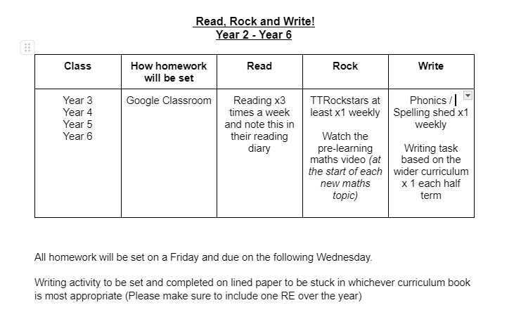

Slide 13
100 books to read before you leave St B challenge.
This year, a new initiative across the school to promote Reading for Pleasure has been introduced..
In the school office area, there is a large display, showcasing the 100 books. The ideas is that the children should strive to read all 100 books before they leave Year 6, and there are awards for reaching the milestones of: 25 books, 50 books, 75 books, and 100 books. The children will have a reading journey folder that will stay in school, and will follow them all the way through their school life.
You will receive an email shortly with more information about the challenge, but for each book the children read, they should complete a book review. These templates will be found in the office, in their classrooms, on Google Classroom and on the school website.
You can support your child in the challenge by:
Talking to them about the challenge and encouraging them to read as many books as possible.
Supporting them to complete the book reviews if they need help.
Taking them to the local library or book shop to find some of the books on the list to read.
Any book reviews completed must be returned to their folder which is kept in school.

Slide 14

Behaviour: Good to be Green
Each child starts the day on green, and they have the opportunity to move up to Gold for exceptional behaviour/effort/work/kindness.
If they are not behaving in line with our class rules, they will receive a verbal warning. They receive 3 verbal warnings, and if they continue to have issues they will be sent to a member of SLT.
PLEASE NOTE: If I have any concerns about your child’s behaviour, I will communicate this with you immediately!
Rewards:
If your child ends the day on Gold, they will be given a sticker.
House points- school-wide.
Merits- school wide.
Roll of Honour- school wide.
Class Marble Jar- when this is full, they will achieve the decided class reward (e.g. pyjama party)
Please remember that a child’s perception of a situation is not always 100% accurate. They may be unhappy that a child has been rewarded, when in fact the previous day that child displayed unacceptable behaviour- rest assured all children will get the chance to shine and be celebrated but there are reasons for my actions - which the children will not be aware of.

Slide 15

The end of day
Some children are already independent walkers, if you would like your child to walk home by themselves, you need to email the office. It can be difficult to control the free walking if the children are unsure. I would ask that you have the conversation with them before school so they know what they are doing.
Please don’t assume that because you may know parents in other year groups, I do because I don’t. If your child is getting picked up by someone else, please let me know either at morning drop off or email/call the school office. If you don’t do this, I cannot let your child go home with them until I have spoken to you.
Thank you

Slide 16

Any questions?

