Slide 1
Meet the teacher
September 2023 – Welcome to Year 4

Slide 2
About me
This is my first year at St Bernadette’s and my first year of teaching.
Across my three years at university I have completed training in year 6, 4 and 2
I am joint PE co-ordinator so I will be aiming to increase participation in sporting events across the school this year alongside Miss Weston in Nursery.
I attended the school as a child and was involved in the school council.
In year 5 I was taught by Mrs Lavelle-Murphy and in year 6 I was taught by both her and Mrs Reilly so I already have a strong working relationship with the head teachers who will ensure I am supported where needed to provide your children with the best education possible.

Slide 3
Staff in year 4
Class Teacher – Mr Reeve
Teaching Assistant - Mrs Choppin supports in the mornings
PPA - Miss Bell covers Thursdays all day

Slide 4
Year 4 TIMETABLE Autumn Term 1 (2023)
Our PE days up until Christmas are Tuesday and Wednesday.
On Tuesdays the children will need their swimming equipment and on Wednesday they will need their normal PE kit.

Slide 5
Behaviour
As a class we have chosen rules and set them to meet expectations and responsibilities.
Positive rewards include Role of Honour, Merit and house points.
As well as these, in class we are using marble jars and table points which aim to encourage good behaviour as a class.
Gold Cards are presented to the children as part of our Good to be Green behaviour policy.
St Bernadette Values (The 5 Bees)

Slide 6
Multiplication check
At the end of year 4 the children will be formally assessed in their times tables.
The test consists of 25 questions ranging from their two times tables up to their 12 times tables.
The children will have 6 seconds to answer each question with a 3 second gap between each question.

Slide 7
How to support your children with their times tables
In school we will be doing regular five minute frenzy tests which vary in difficulty dependent on the level that your child is working at.
As well as this we aim to allow children time each week to learn and practice their times tables on the chromebooks on websites such as purple mash and hit the button.
We also have our times table beach ball
In our starters for our maths work I have times table questions ready for the children to practice.
AT HOME – you could support your children by encouraging them to spend no longer than 10 minutes a night practicing their times table on these websites. Hit the button is free and the children have a login to purple mash which I have printed a copy of for you to take home.

Slide 8
Reading
By the end of this week, each child would have been sent home with a reading book which comes home and back into school each day as well as a library book which they can read for pleasure.
The children will be receiving a physical reading record to monitor reading this year. We are aiming for the children to be recording their reading in their records at least 3 times a week.
We will be doing guided reading in class which will focus on developing their skills of retrieval, inference, summarising and predicting.
Each morning either myself or Mrs Choppin will be aiming to read in class with the children so it is important that their reading books come back into school each morning.

Slide 9
Homework
Homework is posted on Google Classroom on Friday and due to be completed by Wednesday.
WEEKLY
Maths – Pre teaching video explaining what we will be learning next week. Task to be completed to show what has been learnt.
Spelling – Spelling Shed activity set as practiced in class.
EVERY HALF TERM
Topic – task/project linked to the topic being learnt.
RE – an activity or task based on what we are learning.
A writing task that is to be completed on paper.

Slide 10
How you can support your child in year 4
Homework – Help and support your children with homework given.
Reading – Encourage your child to read regularly at home and when possible to have someone listen to them.
Organisation – Help your child to be ready to learn with the correct equipment, PE kits, water bottles, reading records.

Slide 11
100 books to read

Slide 12
Hudnall park residential
This trip will be on 12th – 13th October.
Hudnall Park offers activities designed to develop children's educational, personal and social skills.
Hudnall Park offers a wide range of academic, environmental and adventurous activities.

Slide 13
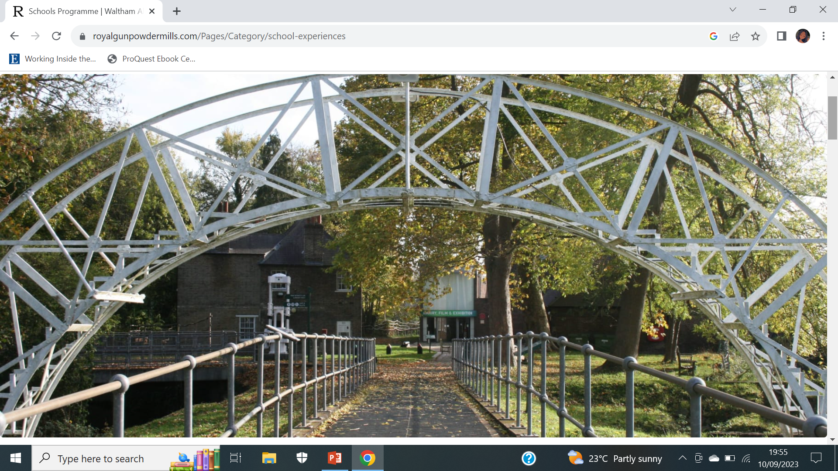
Other upcoming trips
Royal Gunpowder Mills Victorian Experience
Children discover what life was like in Victorian Britain and explore changes to work, education, leisure and transport shaped the world we live in today.
We are also planning a trip to a Hindu Temple for the summer term however a date has not been provided for this yet.

Slide 14
THANK YOU FOR YOUR SUPPORT

